Slide 1
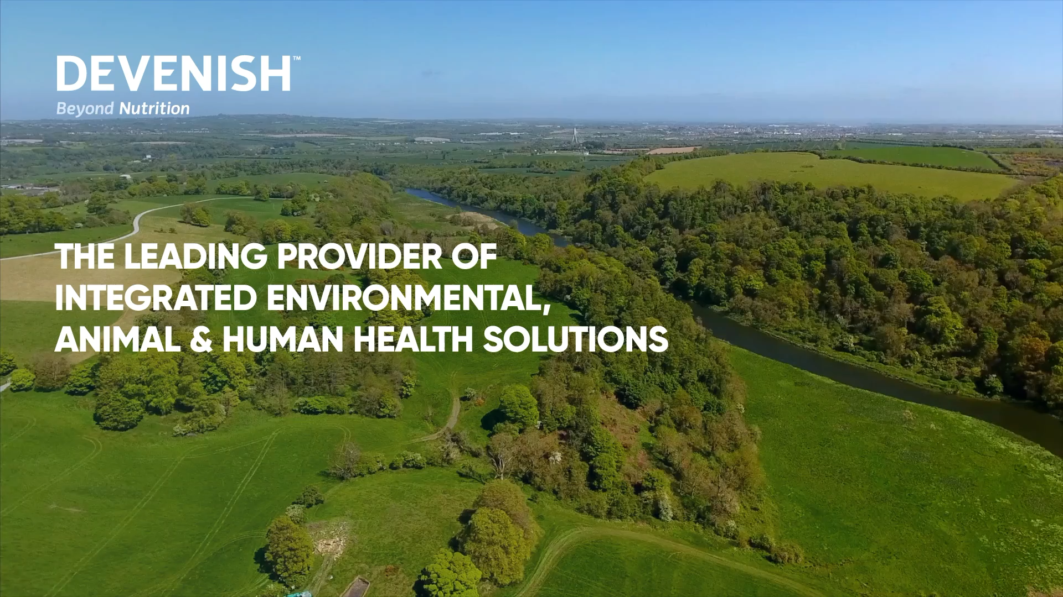

Slide 2
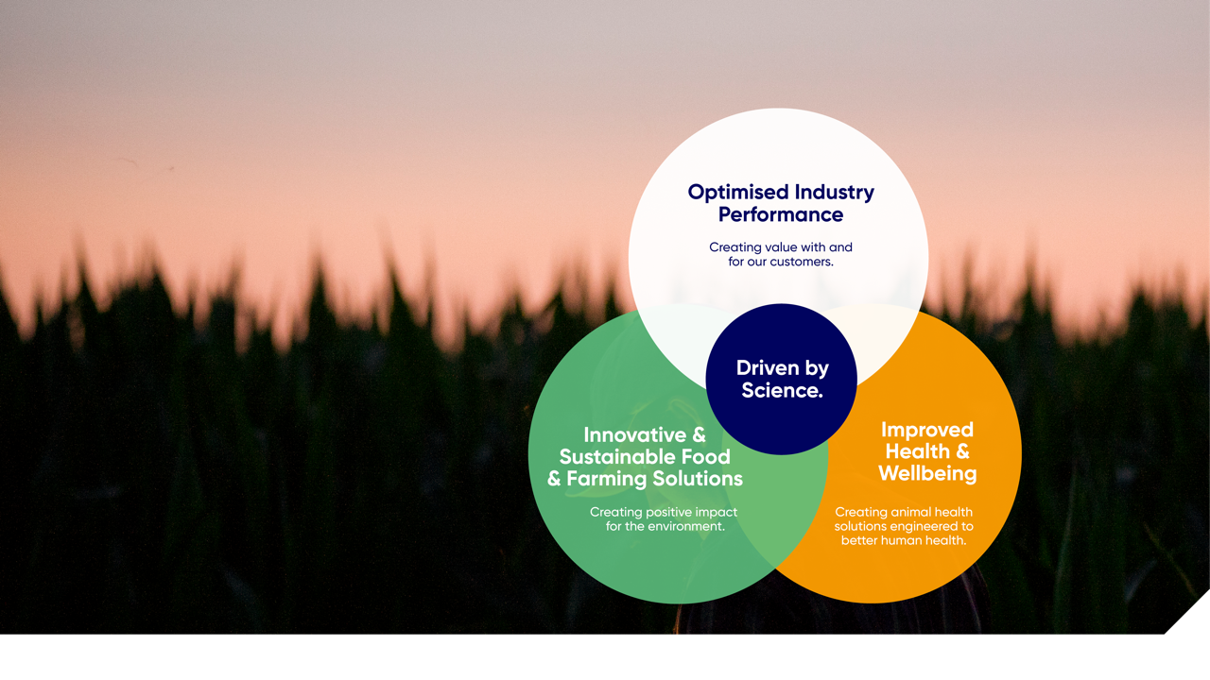
Better nutrients
for a better world.

Slide 3
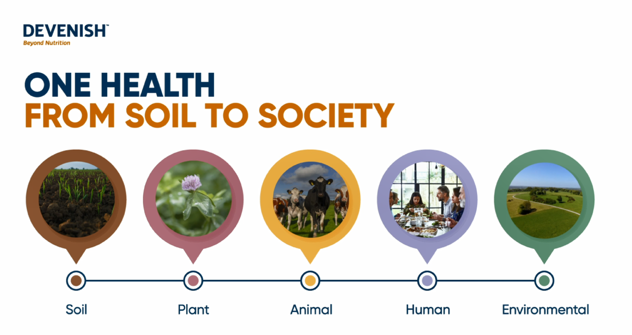

Slide 4
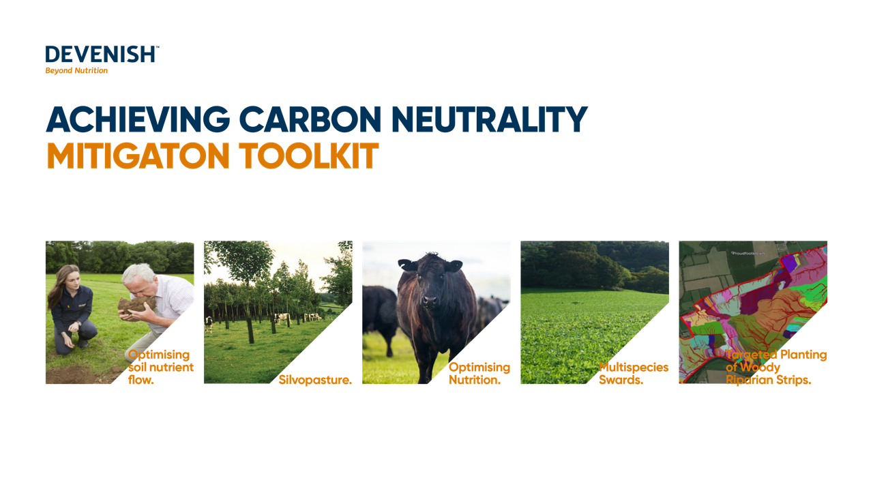

Slide 5
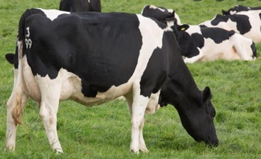
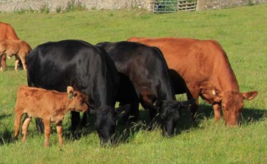
Soil fertility
Ireland
Dairy
21% of soils have optimum pH, Phosphorus and potassium
59% of soils with a soil pH of greater than 6.2
48% of soils at index 1 and 2 for phosphorus
41% of soils at index 1 and 2 for potassium
Beef
18% of soils have optimum pH, Phosphorus and potassium
56% of soils with a soil pH of greater than 6.2
55% of soils at index 1 and 2 for phosphorus
43% of soils at index 1 and 2 for potassium
Teagasc, 2020

Slide 6
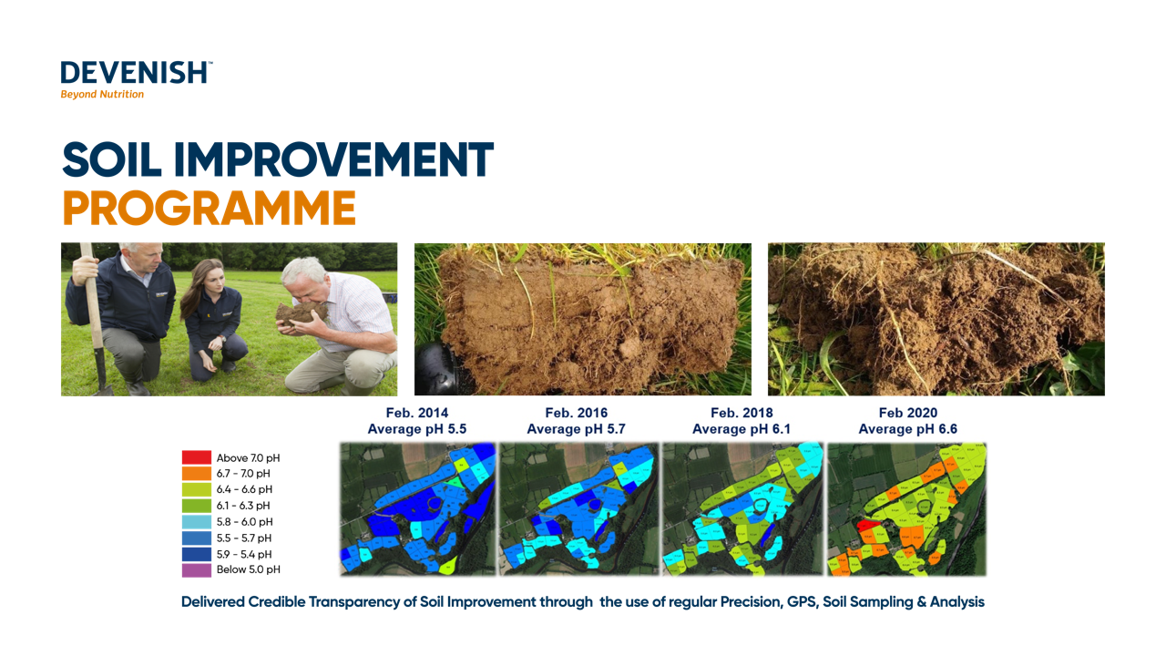

Slide 7


Slide 8
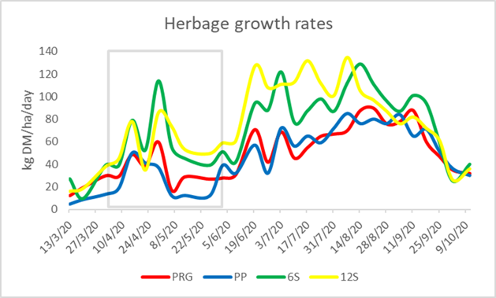
MULTISPECIES
SWARDS
Shackleton et al., 2020
in press

Slide 9


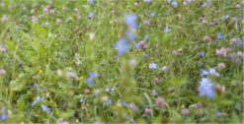
Nitrogen usage
Ireland
Grass utilised Tonnes DM/ Ha
9.1
6
12.15
Nitrogen used kg/ha
180
110
70
Teagasc, 2018 & 2016
Notes:
https://www.teagasc.ie/media/website/crops/soil-and-soil-fertility/Teagasc-Soil-Fertility-Report-2020.pdf

Slide 10
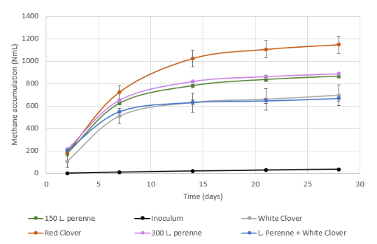
MULTISPECIES
BIOLOGICAL METHANE POTENTIAL
Personal comm. Vincent O’Flaherty NUIG

Slide 11
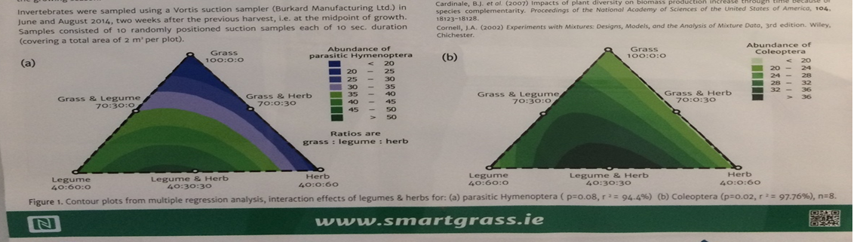
Biodiversity
Wasps and Beetles
Cuddy et al., 2014

Slide 12
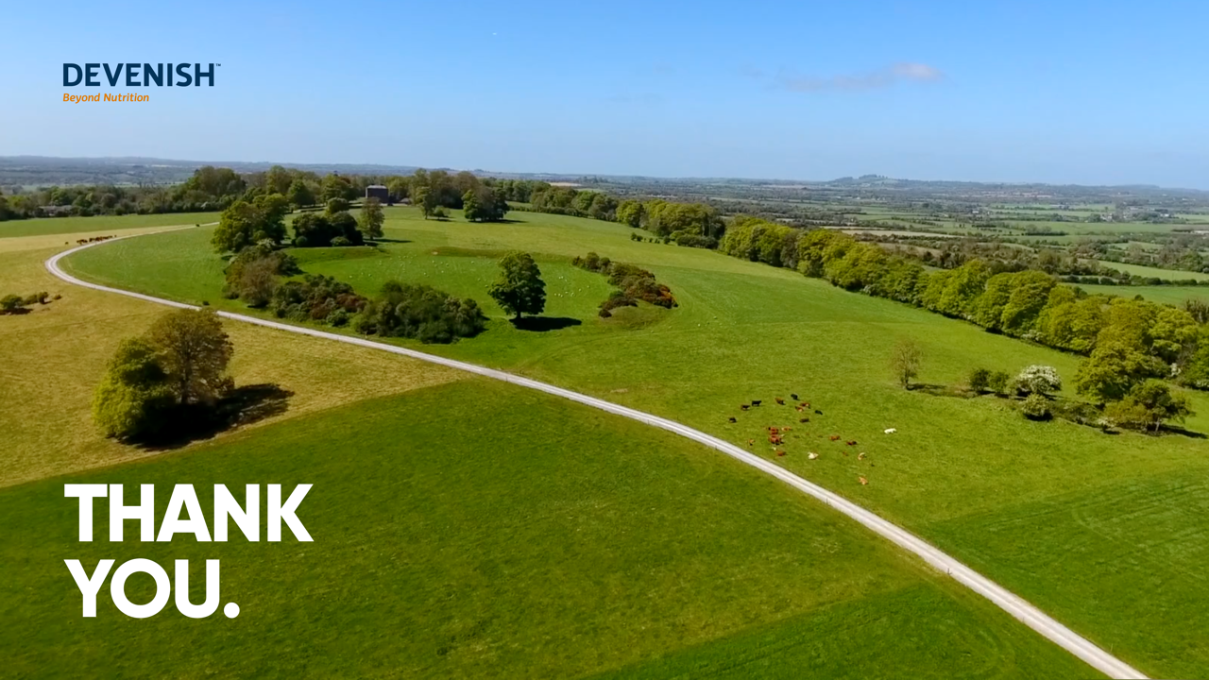

Slide 13
