Slide 1
Communities…. “Low carbon transitions will require new technologies which are unfamiliar to people and uncertain in terms of impacts and benefits – Communities are key to these transitions” JP Prendergast

Slide 2
FINISH
“The Journey so far..”
20yy
START
START
Community Power Green Gas
Community Power
“Community Engagement”
RESS

Slide 3
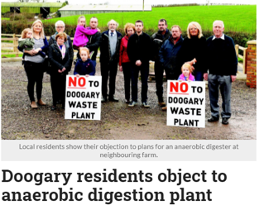
The government had put forward plans to restrict the right of community groups, non-governmental organisations, and citizens from taking legal action against developments around the country.
Among the measures were that groups would have to be in existence for at least three years, have at least 100 members, be personally and substantially affected by a development, and have enough money to cover legal costs.
294 submissions received as part of a public consultation, a significant majority of which opposed the plans.
“a total travesty of the rights of citizens”
“We must be careful not to allow a situation to develop where judicial review in effect becomes a de facto additional step in the planning process for strategically important projects.”

Slide 4
Community Energy Ownership - Examples
Belgium, a renewable energy co-operative, Ecopower, with about 50 000 members, supplies 1.5% of the households in the Flanders region with about 90 gigawatt-hours of renewable electricity from their own wind turbines, PV installations and small hydro. Members pay USD 0.22/kWh, compared with an average retail tariff of USD 0.29/kWh (Statista, 2017). The members also get a dividend of up to 6% per annum on their holdings
In Jühnde, a small village in Germany, a 700 kW combined heat and power plant using biogas was implemented under a co-operative structure. The plant meets 70% of the heating needs of the village and produces double its electricity demand. The excess electricity is fed back into the grid
The community-owned utility in the village of Minster, Ohio, United States, has implemented a 3 MW solar project with a 7 MW, 3 megawatt-hour (MWh) battery storage system. The project has resulted in savings of USD 1 million per year for the community

Slide 5
Community Power are a partnership of community energy groups working for a sustainable energy future for Ireland. The group grew out of Ireland’s first community owned wind farm and now are working with Irish communities to develop more renewable energy projects owned by people!
Community Power looks to empower small-scale local renewable energy producers and revolutionise the way energy is produced. This community generation takes into account the interests of community-based renewable energy producers, or ‘prosumers’, like a small group of village-owned wind turbines, community owned AD plants or rooftop solar panels.
The circular economy, which promotes the elimination of waste and the continual safe use of natural resources, offers an alternative, working with net zero carbon, transitioning to the Paris agreement, working with the farming communities, food processing communities and sustainable energy communities.
Community Power – Then to now!

Slide 7
Renewable Electricity Support Scheme
RESS
A State initiative to incentivise the production of renewable electricity
It has an auction based format
For the production of specific quantities of wind & solar electricity
For a specific time – usually 15+ years
At a set price (successful bids) – with conditions etc
Introduced in 2020 (RESS-1), and expected to run for 4-5 years
The annual RESS auction has two sections/pots
Community pot – 1% of total – less onerous conditions
Developer pot – 99% of total – more onerous conditions
2019 AUCTION RESULT
RESS-1 Auction Results
• 68 projects - 114 applications
• 18 onshore wind projects
• 50 solar projects
• 7 community projects (2 wind, 5 solar)

Slide 8
Community Power – Community Owned AD

Slide 9
The government had put forward plans to restrict the right of community groups, non-governmental organisations, and citizens from taking legal action against developments around the country.
Among the measures were that groups would have to be in existence for at least three years, have at least 100 members, be personally and substantially affected by a development, and have enough money to cover legal costs.
294 submissions received as part of a public consultation, a significant majority of which opposed the plans.
“a total travesty of the rights of citizens”
“We must be careful not to allow a situation to develop where judicial review in effect becomes a de facto additional step in the planning process for strategically important projects.”

Slide 10
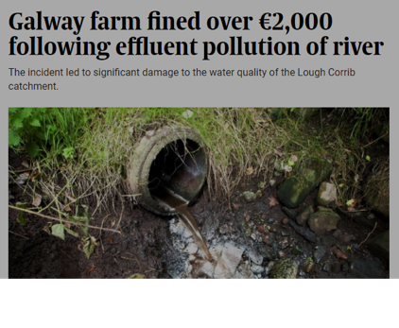
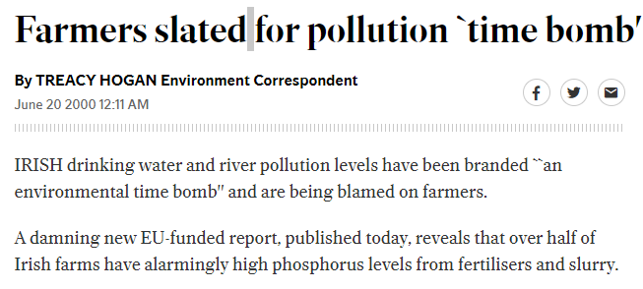

Slide 11
Its all down to Breaking Barriers

Slide 12
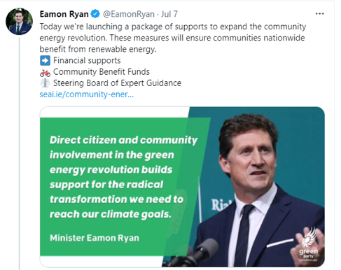
Community Power Green Gas
Community Power in collaboration with the RGFI are presently working with over 70 Sustainable Energy Communities.
Community Power presently sit on the “Steering Board of Expert Guidance”

Slide 13
NEXT STEPS – Community AD Support/Ownership
Community Engagement
To promote European Led Funding Programs involving Community
To develop funding progams similar to RESS for Community Owned AD
To influence policy including lobbying
Enable Framework Inputs
Financing for Community AD Projects
Establish Trusted Intermediaries/Advisors – “How To” supports
Community Engagement – National/EU
To promote education and awareness through information programmes/awareness sharing
To promote involvement and participation
To promote the wider Circular Bio-Economy models incorporating AD
Continue to work with the EU to agree community participation as an integral part of installing new renewable energy and a route for community participation in the projects.
Community Power Nationwide
to promote & protect the interests of the 100% community owned generation projects
to protect the energy community pot for these communities
to influence policy including lobbying when and where appropriate.

Slide 14
“Including people and communities in the design, planning and implementation of the transition to zero carbon societies is not simply the fairest approach. It will also be the fastest”.
Thank you…

