Slide 1
Renewable gas in the REPowerEU plan
Renewable gas forum Ireland, 31 May
Matthieu Ballu
European Commission DG ENER

Slide 2
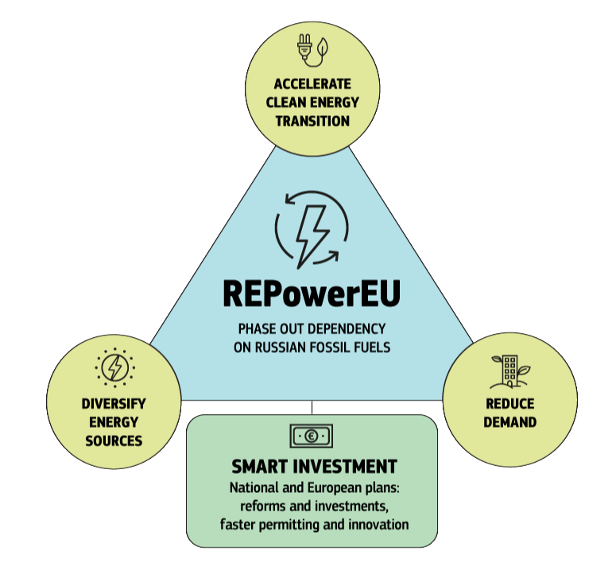
REPowerEU: from goals to actions
Independence from Russian fossil fuels by 2027
Increase imports of liquefied natural gas (LNG) by 50 bcm
Increase pipeline gas imports by 10 bcm
Increase biomethane production by 3.5 bcm
EU-wide energy saving to cut gas demand by 14 bcm
Rooftop solar to reduce gas demand by 2.5 bcm
Heat pumps to reduce gas demand by 1.5 bcm
Reduce gas demand in the power sector by 20 bcm by deployment of wind and solar
Increase the target of renewable energy from 40% to 45% by 2030
Increase the target of energy savings from 9% to 13% by 2030

Slide 3


Diversification of gas supplies
April 2021
April 2022
LNG
EU-US Joint Statement and Task Force on European Energy Security
EU Energy Purchase Platform
Trilateral agreement with Egypt and Israel
Increased imports via Japan, Korea, Qatar
Untapped potential in sub-Saharan Africa
Other sources: UK
Russian share of pipeline gas imports
40%
26%
Russian share of total gas imports
45%
31%
12.6
bcm
Total EU LNG imports – a record high
Pipelines
Norway
Algeria
Azerbaijan
Increase in LNG imports year-on-year
39 %

Slide 4


Renewable gases
Hydrogen
Renewable hydrogen accelerator : 10 million tonnes each of domestic production and imports by 2030
Regulatory framework: delegated acts and standards
Accelerate hydrogen projects with IPCEI funding
Faster deployment of infrastructure supported by CEF funding
Progress report on hydrogen uptake by 2025
A global hydrogen facility and green hydrogen partnerships
The objective of 17.5 GW of electrolysers capacity
Biomethane
Dedicated plan to double production by 2030 to 35 bcm bio-methane a year
EUR 36 billion investment needs eligible for EU co-financing : CAP, RRFs, regional structural funds ...
Establishment of an industrial biogas and bio-methane partnership to stimulate the renewable gases value chain

Slide 5
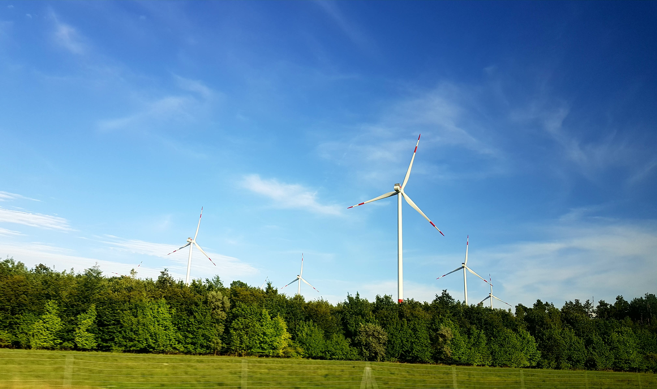
Thank you

