Slide 1
The voice of renewable gas in Europe
REPowerEU: Joint European action for more affordable, secure and sustainable energy
24/05/2022
Mieke Decorte
decorte@europeanbiogas.eu

Slide 2
BACKGROUND
Following the invasion of Ukraine, the case for a rapid clean energy transition has never been stronger and clearer.
The EU imports 90% of its gas consumption
With Russian providing around 45% of those imports
In varying levels across Member States.
Russia also accounts for around 25% of oil imports and 45% of coal imports.
Ban on Russian coal imports has alredy been agreed on
Gradual phase out of oil by end-2022 currently under discussion
➔ the RePowerEU plan focuses on how to phase out of Russian gas by 2027

Slide 3
EU’s PLAN TO CUT OUR DEPENDENCE ON RUSSIAN GAS
8 March 2022: The European Commission has proposed an outline of a plan to make Europe independent from Russion fossil fuels well before 2030, starting with gas, in light of Russia’s invasion of Ukraine.
18 May 2022: REPowerEU action plan has four main dimensions
Energy Efficiency
Supply diversification
Energy Transition acceleration ➔ target of 35 bcm of biomethane
Investments and reforms ➔ o.a. revised Recovery and Resilience Plans, ad-hoc RePowerEU grants

Slide 4
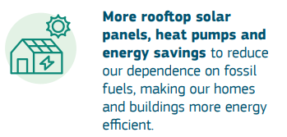
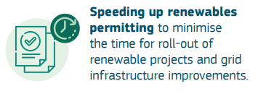
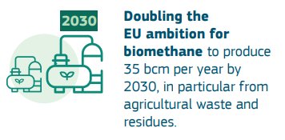
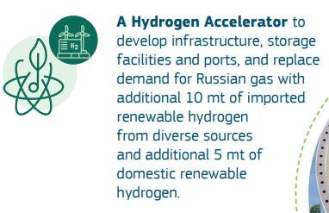
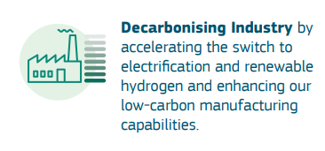
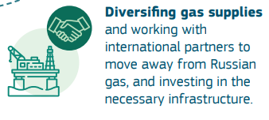
EU’s PLAN TO CUT OUR DEPENDENCE ON RUSSIAN GAS

Slide 5
Biomethane production can contribute to energy security
and resilience by replacing 10% of today's EU gas demand by 2030
Scale-up efforts: REPowerEU
The potential is strong enough to deliver 35 bcm in 2030
This scale-up can be done using only sustainable feedstocks
+87%
+127%
400
370
355
3 bcm
Industrial wastewater
350
300
165
190
250
16 bcm
Livestock manure
200
190
150
35 bcm
150
2 bcm
Food waste
100
30
50
10 bcm
Agri residues
0
0
Today
FF55
2030
Today
FF55
2030
REPowerEU
REPowerEU
Equivalent to 10% of today’s natural gas demand
20% of gas imports from Russia
4 bcm
Sequential crops
Green hydrogen
Biomethane
Notes:
[Set the scene] Biomethane production can contribute to energy security and autonomy by replacing 10% of today's EU gas demand by 2030
The potential is solidly assessed: Figures of EU production potential in 2030. This is equivalent to 20% of import of Russian gas
This can be done sustainably: Breakdown per feedstocks
Our EU industry can deliver: mature, world leader, innovative.

Slide 6
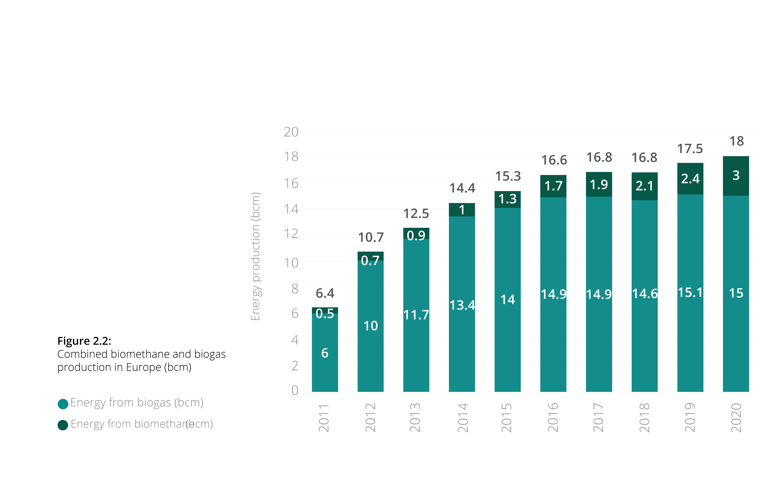
BIOGAS AND BIOMETHANE PRODUCTION IN EUROPE
Europe produces today (2020):
15 bcm of biogas
3 bcm of biomethane
Upgrading biogas to biomethane can thus highly contribute to this 35 bcm target.

Slide 7
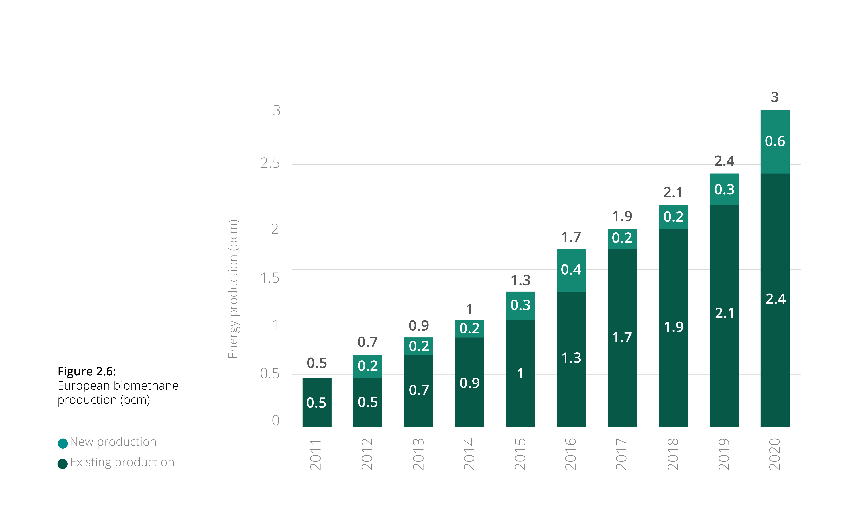
BIOMETHANE PRODUCTION IN EUROPE
Biomethane growth rate in 2020 was 25%.
An even bigger increase is expected in 2021, as a record number of new biomethane plants started production in 2020.
The 35 bcm target represents a growth rate of 32% each year until 2030.

Slide 8
BIOMETHANE AND BIOGAS PRODUCTION
This graphs shows the percentage of the gas consumption which could be covered with biomethane if all biogas were upgraded.
Both Denmark and Sweden are well on track to replace their natural gas consumption with biomethane.
Energinet reports Denmark already reaches 25% by October 2021.

Slide 9
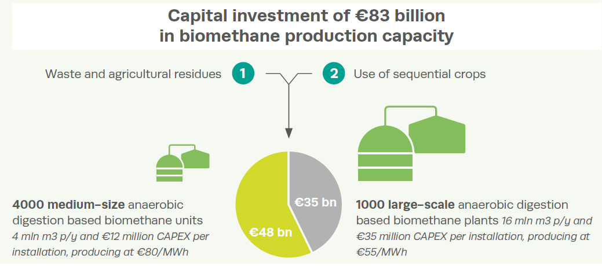
For a rapid scale up, the sector will need additional investments
Source EBA Statistical Report 2021

Slide 10
REPOWER EU: BIOMETHANE ACTION PLAN
Actions are grouped under 5 areas:
Promoting production, use and injection in the grid
Providing Incentives for biogas upgrading into biomethane
Promoting adaption of existing infrastructure and the development of new infrastructure for biomethane through EU gas grid
Address RND&I gaps
Access to finance

Slide 11
REPOWER EU: BIOMETHANE ACTION PLAN
AREA | ACTION | Comment
I. Promoting production, use and injection in the grid | Creation of a Biomethane Industrial Partnership | Largely responds to EBA and Sustainaible Biomethane Initiative request.
 | National Biomethane Strategies | Coordination will be needed to ensure MS are applying harmonized methodology for the potentials assesment.
 | Consider broadening the scope of the fuel supply obligation in the RED (art. 25) | This could correspond to a biomethane blending mandate.
 | Promote particularly mutli-stakeholder engagement. | Broad action, bringing visibility to the sector and its interdepence with rural communities.
 | Reduce red tape and speeding up permitting.
 | Promote sustainable biogas and biomethane co-operation with neigboring and enlargement countries. | Could increase business opportunities for technology suppliers to supply equipment to neighboring countries.

Slide 12
REPOWER EU: BIOMETHANE ACTION PLAN
AREA | ACTION | Comment
II. Provide incentives for biogas upgrading into biomethane | Considering sharing of grid connection costs + lifting of injection costs (as in the Gas Package)
III. Promote the adapation and adjustment of the existing infrastructure and the deployment of new infrastructure for the transport of increased shares of biomethane through the EU gas grid | Carry out regional assessment of network development and matching it with the potential of sustainable biomethane production. | Similar to ‘Zoning approach’ applied in France.
 | Assess challenges & bottlenecks from the infrastructure perspective for the cost-efficient deployment of biomethane. | There will be the possibility to be included in the list of Projects of Common Interest.
 | Addres gas quality standardization issues. | This will facilitate cross border trading and flow.

Slide 13
REPOWER EU: BIOMETHANE ACTION PLAN
AREA | ACTION | Comment
IV. Address RND&I gaps | Provide further support to the development of innovative technologies for the production of sustainable biogas and biomethane. | Possible new Horizon or LIFE calls to be expected.
 | Provide further support the innovative solutions and research on barriers. | Specific reference to learn from the REGATRACE and BIOSURF projects.
 | Further support the expansion of sustainable biomass feedstock. | Possible calls on sequential cropping systems, innovative biomass types and biomass production from marginal land.
V. Access to Finance | Provide acces to grants and loans. | a.o. the Common Agriculture Policy, National Resilience and Recovery Plans, Horizon Europe etc. – variety of financial instrumtents.
 | Innovation Fund | Specific REPowerEU calls to be launched. Very positive for medium and large size projects.

Slide 14
Some member states already have best practice policies to build upon
Sweden
The proportion of biomethane in liquefied gas vehicles has increased from approximately 50% in 2020 to 65% in 2021. During the same period, use has doubled. When it comes to vehicles using compressed gas, which is used for cars, trucks and buses, the proportion is 96%.
France
France is home to Europe’s fastest growing biomethane sector. The total biogas production amounted to 6,083 GWh and the biomethane production was 2,207 GWh.
Denmark
Today, 25% of gas injected in the grid is biomethane
Italy
Italy forecasts that within 2-3 years the entire Italian NGV fleet (approximately 1,050,000 vehicles) will be powered 100% by biomethane.
Biogasdoneright concept supports development of agroecology with biogas and biomethane.

Slide 15
Some member states already have best practice policies to build upon
Stimulating the role of biomethane can be achieved through different policy mechanisms i.e. national taxes and subsidies or EU target setting. It is key to implement effective national policies which interfere minimally with European cross-border trade.
Denmark
Production subsidy does not differentiate on basis of facility size
Use of biomethane falls within EU ETS
All biomethane produced counts towards Danish climate targets, making it difficult to market biomethane cross-border with different regulatory schemes
Sweden
CO₂ tax and energy tax exemption for use of biogas and biomethane
Exemption also available to imported biomethane
The Netherlands
Biomethane blending mandate of 20% in 2030
SDE++ subsidy for production
REDII implementation strong push for biogas liquefaction
Subsidised biomethane produced counts towards Dutch climate target
France
Zoning approach for techno-economic optimization of production facilities
Italy
High level of financial support for biomethane use in transport
Recently developed incentive scheme for (new) biomethane plants

Slide 16
THANK YOU!
Mieke Decorte, Technical and Project Manager
decorte@europeanbiogas.eu
Re-thinking our economy. Making the energy transition happen.
www.europeanbiogas.eu
Follow us on

