Slide 1
The REGATRACE project
Mieke Decorte, EBA
Dublin,
1 June 2022
This project receives funding from the European Union’s Horizon 2020 Framework Programme Research and Innovation under Grant Agreement no. 857796

Slide 2
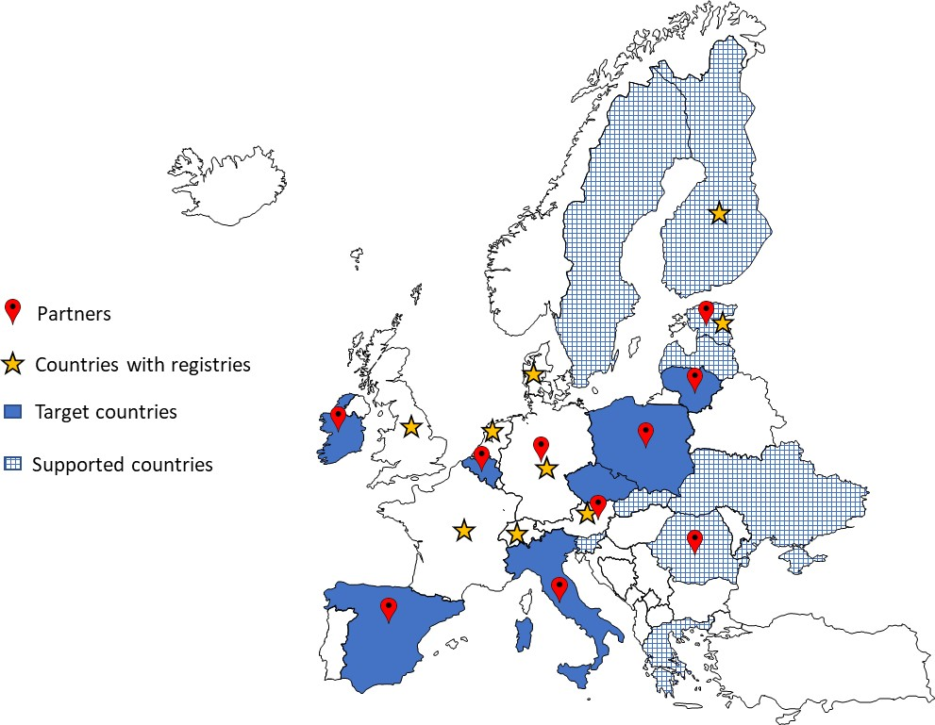
Project Summary
REGATRACE: REnewable GAs TRAde Centre in Europe (HORIZON 2020);
42 months (June 2019- November 2022);
16 partners in 11 countries: ISINNOVA, CIB (IT), EBA, AIB, ERGaR, Fluxys (BE), RFGI (IE), DENA, DBFZ (DE), AGCS (AT), Elering (EE), UPEBI (PL), ARBIO (RO), NEDGIA (ES), Amber (LT), CzBA (CZ), ARBIO (RO)
10 EBA Linked Third Parties + 5 ERGaR Linked Third Parties
3.000.485,00 € of EC funding (100%);
REGATRACE workshop, 1 June 2022

Slide 3
Project objective
The aim is to create an efficient system based on issuing and trading biomethane/renewable gases certificates (including GoO and PoS) and to support market development (with several guidelines, participatory workshops, etc.);
REGATRACE workshop, 1 June 2022

Slide 4
Set-up of national GoO issuing bodies
Guidelines for establishing national biomethane registries
Set-up of national/regional biomethane registries in the target countries (BE, ES, IE, IT, LT, POL and CZ).
REGATRACE workshop, 1 June 2022

Slide 5
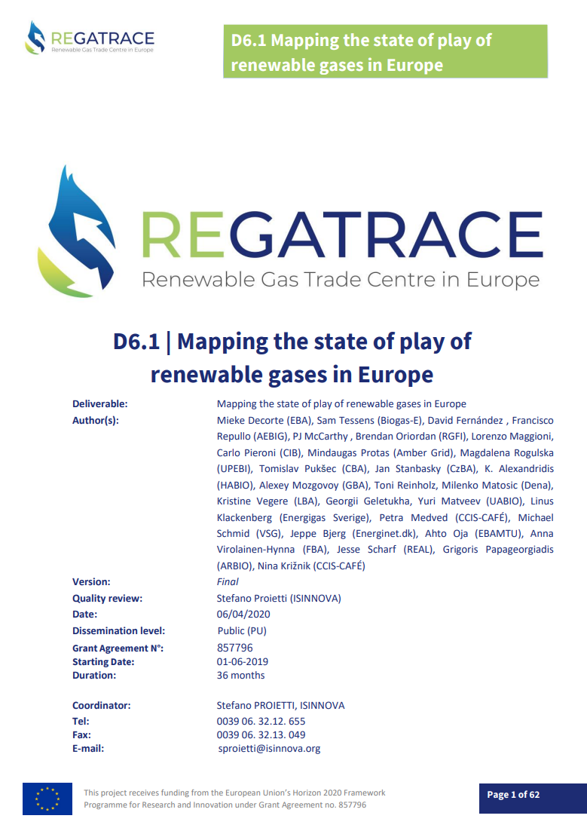
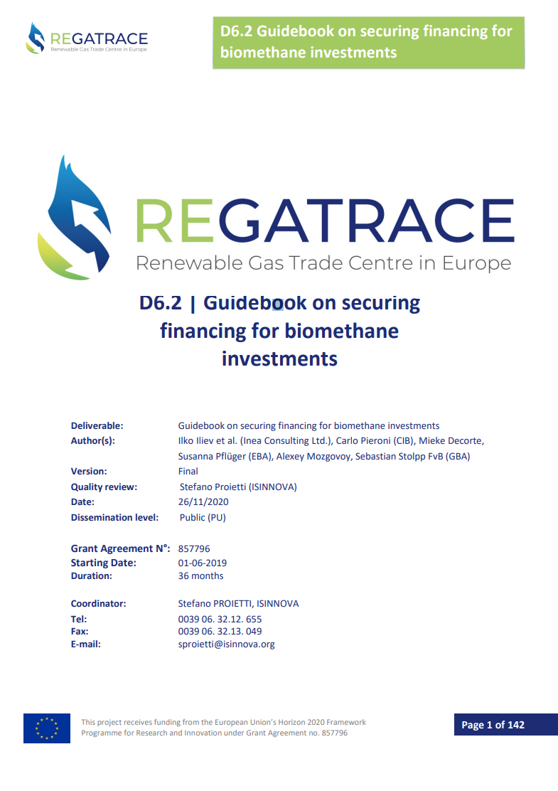
Support for biomethane market uptake
Activity 1: Mapping on the state of play of renewable gases market in Europe
23 European countries
Published in April 2020
Activity 2: Guidebook on securing financing for biomethane investments
Sources of capital investigated for 24 European countries
Published in November 2020
REGATRACE workshop, 1 June 2022

Slide 6
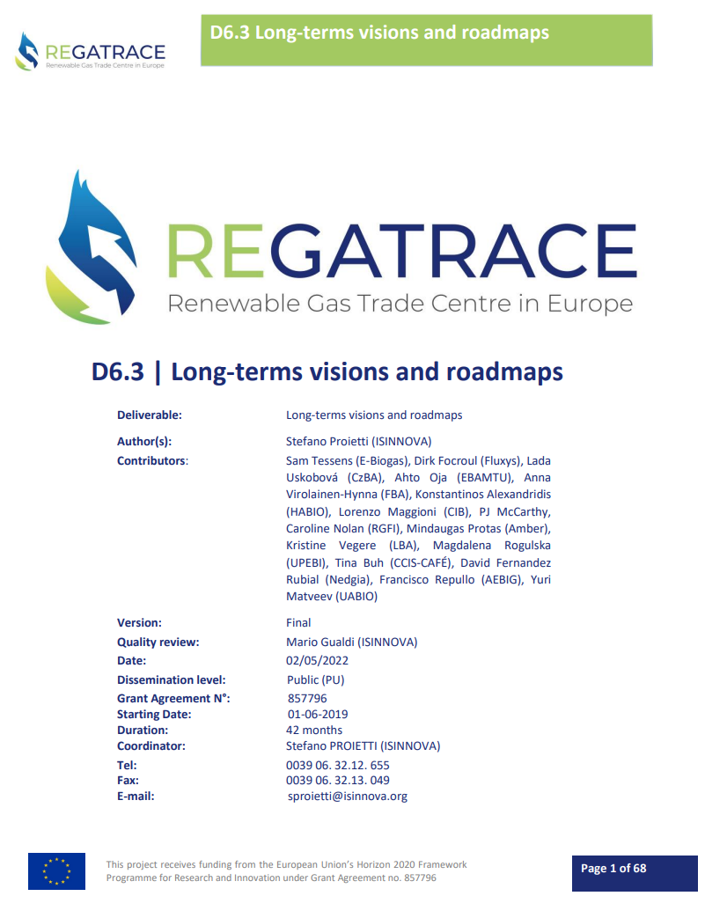
Support for biomethane market uptake
Activity 3: Development of national strategic visions and roadmaps
Through 4 participatory workshops
14 European countries
Published in May 2022
Activity 4: Guidance for feasibility analysis
Through 4 participatory workshops
Incl. a feasibility case study for 6 countries (BE, CZ, ES, IE, IT, and PL)
13 European countries
To be published by September 2022
REGATRACE workshop, 1 June 2022

Slide 7
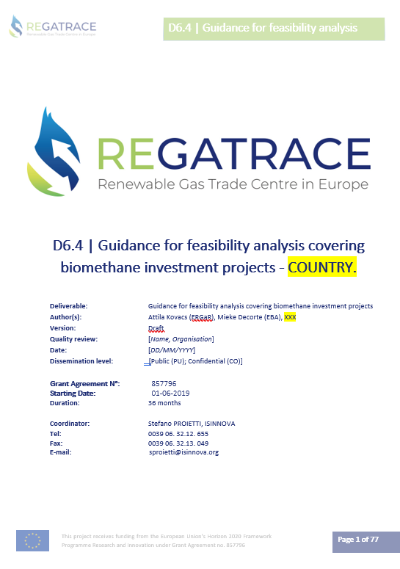
D6.4 Guidance for feasiblity analysis covering biomethane investment projects (lead: EBA)
Technical feasiliby
Market feasibility
Commercial feasibility
Overall risk assessment
REGATRACE workshop, 1 June 2022

Slide 8
D6.4 Guidance for feasiblity analysis covering biomethane investment projects (lead: EBA)
Producing country tailored guidance on feasibility analysis
Based on a general guidance on European level
Through a participatory process
Including feasibility studies for specfic countries (BE, CZ, ES, IE, IT, PL)
The guidance for feasibility analysis is designed to assist project developers in realising biomethane investment projects based on political, economical, technical, environmental, route to market, optimal scale and financial factors influencing the feasibility of the biomethane investment projects.
REGATRACE workshop, 1 June 2022

Slide 9
D6.4 Guidance for feasiblity analysis covering biomethane investment projects (lead: EBA)
The general guidance on European level is tailored with country specific information by the national biogas associations.
In view of specific circumstances prevailing in the country.
Adapted to local circumstances for enabling direct usage by interested parties in the country.
The paper contains The Example of cash flow calculations for an imaginary biomethane plant with imaginary numbers.
Third participatory workshop: presentation of the draft results Fourth participatory workshop: presentation of consolidated guidance for feasibility analysis
REGATRACE workshop, 1 June 2022

Slide 10
What is the feasibility study?
The feasibility analysis is used to determine the viability of a project idea, ensuring the project is legally and technically feasible as well as economicall justifiable.
The feasibility study answers the basic question whether the project is worth the investment.
A feasibility analysis evaluates the project’s potential for succes. Its perceived objectivity is an essential factor for the credibility of the study both for potential investors and lending institutions.
Should we preceed with the specific investment project?
REGATRACE workshop, 1 June 2022

Slide 11
Where can de feasibility study be used for?
Two types of invesments are covered.
The guidance focuses on the feasibilty of a «green-field» biomethane investment project
Nevertheless, it can be used as well to convert an electricity generating AD plant to a biomethane producer
Based upon the analysis, the project developers can approach potential investors and financing institutions.
Th study will also assist the project developers in their communication with the respective authorities and politicians in securing their support for the project.
REGATRACE workshop, 1 June 2022

Slide 12
REGATRACE mention in REPowerEU
Among the actions in the The Biomethane Action Plan, the EC highlights the integration of research results, including REGATRACE, in the pan-European methane grid access action plan.
This gives great opportunity to especially D7.3 Recommendations for EU and national policy makers to be recognized by policy makers.
REGATRACE workshop, 1 June 2022

Slide 13
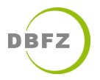
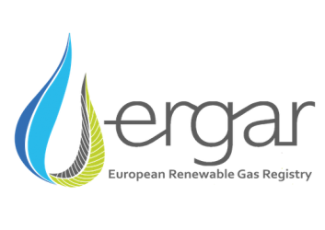
Thanks for your attention!
Stefano Proietti, Loriana Paolucci
ISINNOVA
Contact details
sproietti@isinnova.org
lpaolucci@isinnova.org
www.regatrace.eu
www.isinnova.org
This project receives funding from the European Union’s Horizon 2020 Framework Programme Research and Innovation under Grant Agreement no. 857796

