Slide 1


Biomethane Knowledge Exchange, 1 June 2021
PJ McCarthy, CEO, RGFI

Slide 2
REGATRACE in Ireland
RGFI lead partner and host
4 workshop events – April 2021, July 2021, Dec 2021
Over 100 people from over 60 organisations directly engaged
Government, Academia, Consultants, Technical, Industry

Slide 3










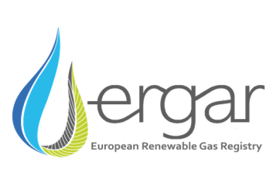
Our thanks go to those who presented at these workshops, including today

Slide 4
European Overview
The vision across Europe
Brussels updates
Mapping the state of play of the renewable gases market
D6.4 Guidance for Feasibility Analysis
Covering Biomethane Investment Project
Roadmapping
REGATRACE Ireland Workshop Presentations and Discussion Topics
Ireland Context
Renewable Gas Registry and the potential market in the Ireland
Business Plan for the development of Biomethane in Ireland
Urban hubs - Sligo Local Gas Network
Community engagement in renewable energy
Project Clover
Regenerative agriculture and AD

Slide 5
REGATRACE Activities
Ireland Roadmap
Guidance on feasibility analysis
Collaboration / knowledge exchange
Developing market conditions
Business Plan for Development of Biomethane in Ireland
Liaison with government and agriculture organisations
Government RHO consultation
Transport policy consultation
Local government area plans
Agri-Industry and Transport Collaborations
Green Gas Certification / Registry (GNI)
REGATRACE and wider RGFI activities (in green) were complementary
Through EBA – influencing the increased ambition for biomethane across Europe

Slide 6
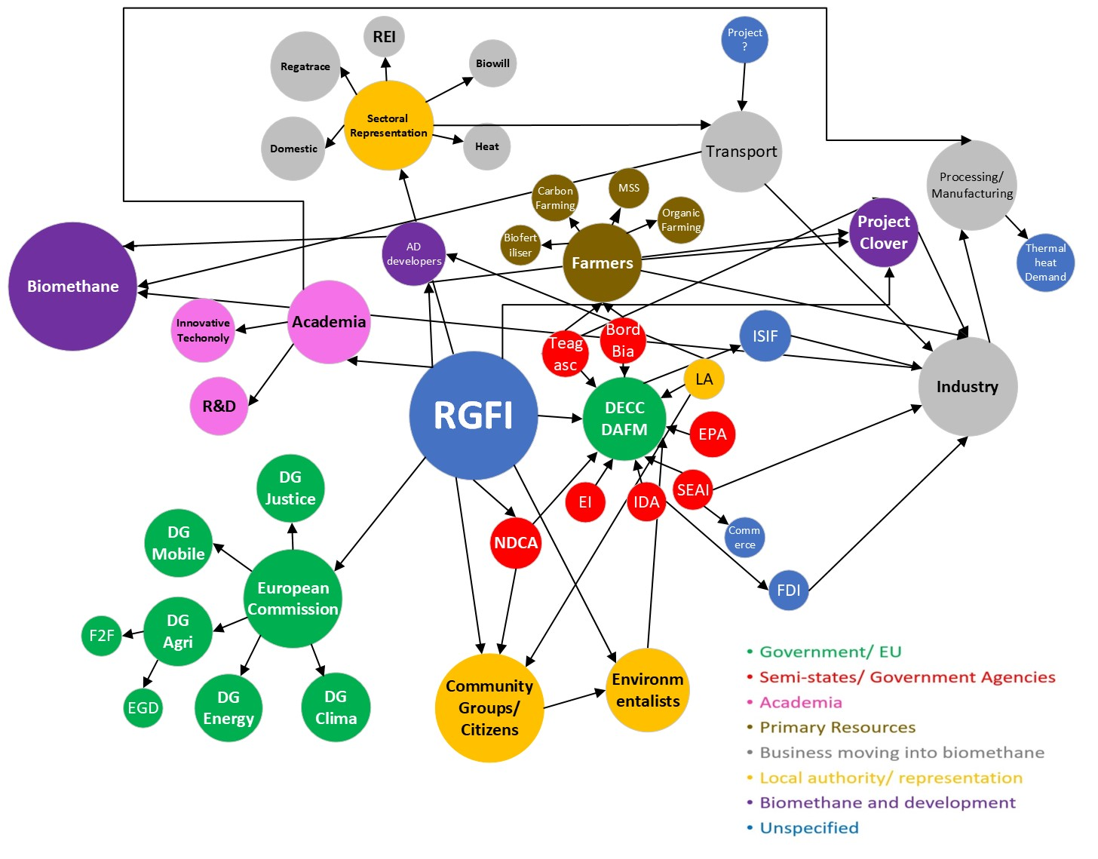
RGFI has an Extensive Social Network beyond REGATRACE through its membership, projects, representations and collaborations

Slide 7
IRELAND ROADMAP – VISION FOR BIOMETHANE
The vision is for a consumer-led collaboration, at scale, with a renewable gas industry that incorporates the socio economic benefits and environmentally responsible production and use of biomethane and its role in the circular bio-economy:
decarbonising difficult to decarbonise sectors ie the thermal demands of industry, and agriculture;
supporting sustainable, diverse, profitable agriculture and the circular rural bio-economy and its principles;
supporting sustainable transport;
aligned with EU and national sustainability and climate action policies;
with Green Gas Certification in place;
underpinned by a nature positive AD Charter

Slide 8
IRELAND ROADMAP – BARRIERS / OBSTACLES
Lack of a Renewable Heat Obligation to bridge the funding gap.
Need to adjust the GBER exemption threshold to allow capital funding required and related structure / mechanism to support the establishment of a mature biomethane industry.
Lack of understanding of the benefit of AD biomethane to the environment, energy security, storage and pricing and the circular bio-economy.

Slide 9
IRELAND ROADMAP - DRIVERS AND OPPORTUNITIES
Industry led collaborations (agri-food and transport), working in consultation with Government and farmers to decarbonise their thermal processes and support zero carbon farming.
National and international imperative to address climate change by decarbonising.
The need to develop indigenous, secure energy supplies, storage and pricing and the implementation of the REPowerEU plan, aligned with capital grants for AD biomethane plants.
Implementation of a Renewable Heat Obligation Scheme in 20232/23 to bridge the funding gap.
A National Biomethane Strategy.
Need to support farmers and regenerative agriculture and to sustain diverse farm income .
Research and innovation on sustainable agri feedstock AD biomethane and biofertiliser sustainability, available feedstock and the potential for multi spp swards , food and energy .production systems.
The business case and commercial feasibility studies for sustainable Agri feedstock AD biomethane, biofertilisers and related products, Carbon Farming Initiative.
Development of Teagasc Grange Centre of Excellence for AD biomethane.
RGFI as a national co-ordination and design authority and its role in representing its members, developing collaborations and knowledge exchange.

Slide 10
IRELAND ROADMAP - ELEMENTS TO 2030
Announcement of a Renewable Heat Fuel Obligation scheme.
Increasing price of carbon, EAU, (REGATRACE workshop participants ranked a higher carbon price tax above exchequer funding and other tax incentives).
Government support with matched capital funding of 50%
Consultation with industry on the optimum economic structure for national carbon.
The Green Gas Certification Scheme / Guarantees of Origin – Government to sign off on the Statutory Instrument on appointing GNI as the operator the Renewable Registry .
AD biomethane can deliver cross sectoral benefits in decarbonising agriculture, food production, manufacturing and processing and transport, while being a central enabler for circular bio economy.
Research, knowledge and information transfer especially in relation to co-products such as grass biorefining (protein extraction), bio-fertilisers and soil carbon sequestration and climate neutral farms.
Greater public awareness of the opportunity to decarbonise and sustainable carbon cycles and the associated environmental benefits.
Biomethane as part of an Integrated Energy System (renewable) energy portfolio in Ireland.
Other bio-based products, such as bioactives and biostimulants promoting technological solutions for carbon capture and use (CCU) and the production of sustainable advance biofuels or other non-fossil based food, feed or carbon products.

Slide 11
The Ireland Biomethane Roadmap can be downloaded on
www.renewablegasforum.com
Save the Date
Ireland Biomethane Conference 2022
9 and 10th November, Clontarf Castle Hotel
THANK-YOU

