Slide 1
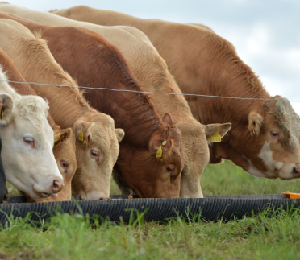
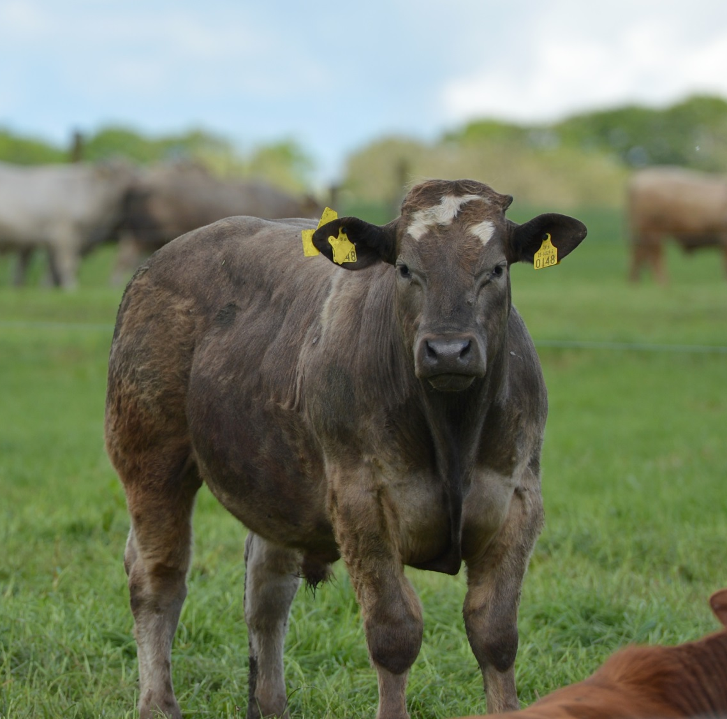
Teagasc research for AD biomethane
Paul Crosson
Teagasc Grange
Presentation at the REGATRACE Knowledge Exchange Event
1 June 2022

Slide 2
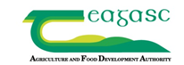
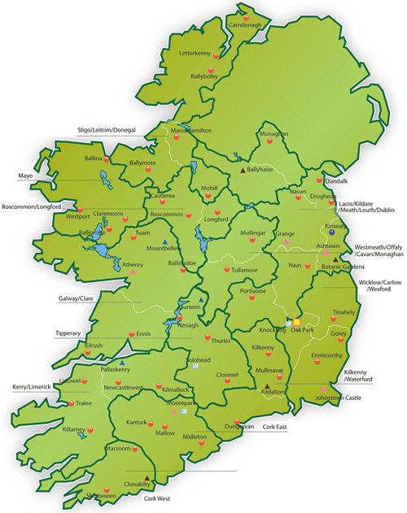

Teagasc – who are we?
Teagasc – the Agriculture and Food Development Authority – is the national body providing integrated research, advisory and training services to the agriculture and food industry and rural communities
  Four research programmes
  Twelve advisory regions
  Four agricultural colleges

Slide 3
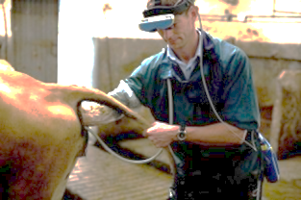
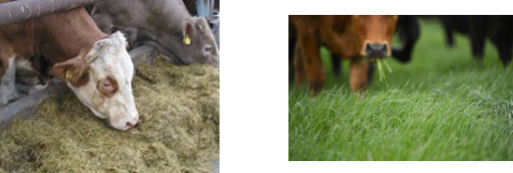
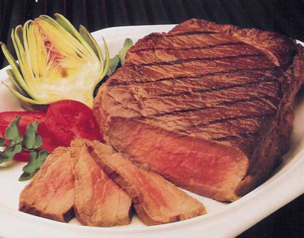
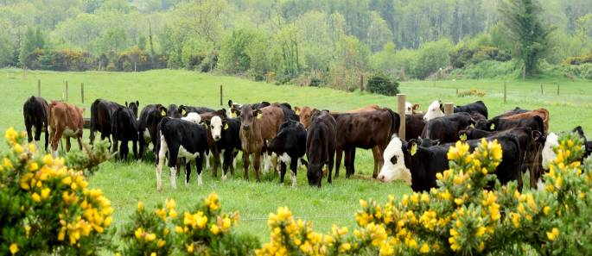
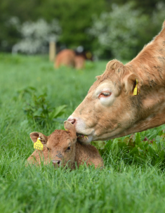

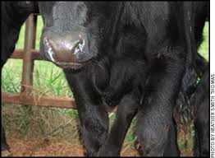
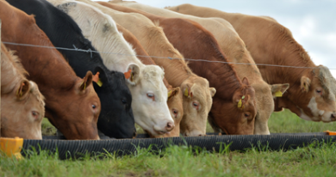
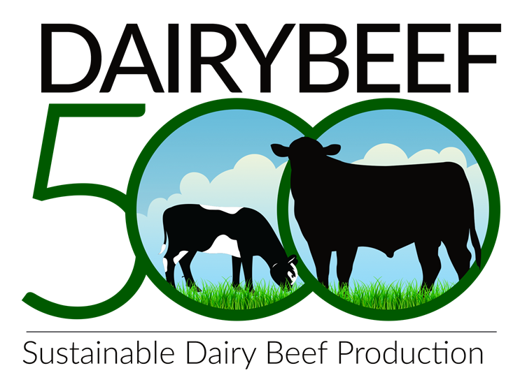

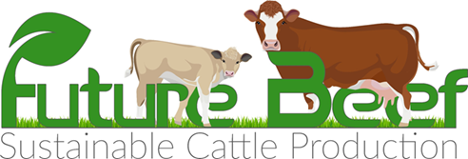
Teagasc Grange
Beef Research Centre: 230 ha permanent grassland
Animals: ~1 200, including two suckler beef cow herds & dairy calf to beef herd
Housing: purpose built accommodation including individual feeding units and methane measurement
Laboratories: forage/nutrition, animal blood/tissue, molecular labs
Anaerobic digestor – undergoing final stages of construction
Close cooperation with KT and advisory colleagues
7. Beef Systems Evaluation
1. Reproductive Efficiency
2. Grazing & Forage
3. Animal Nutrition
4. Health & Welfare
5. Meat Quality
6. Environment

Slide 4
Overview of Current Teagasc AD Research
Biomass availability
Plant construction
Optimizing number and location of plants
Feedstock options
Pilot AD Plant

Slide 5
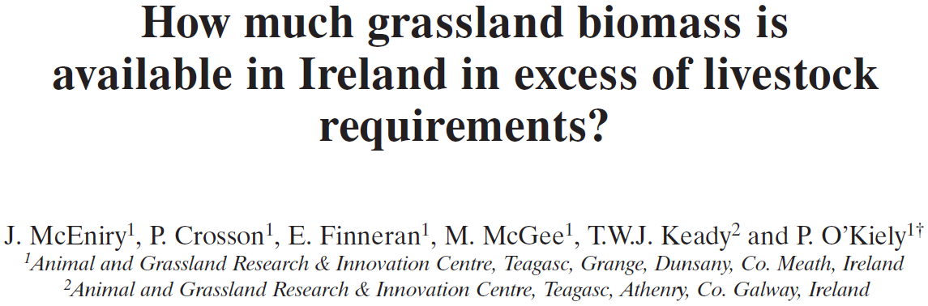

Availability of feedstock from grasslands
Forage biomass surplus
  2013, 5.6 Mt DM
  2020 (f), 4.6 Mt DM
  [up to 12.2 Mt DM]
 | Industry Current | Industry 2027 | High performance target
Organic N (kg/ha) | 116 | 136 | 202
Herbage utilised (t per ha) | 6.2 | 7.2 | 10.6
Forage (% of feed budget) | 93 | 92 | 92
Source: Teagasc Beef Roadmaps

Slide 6


GHG emissions association with AD plant construction (Teagasc Grange)

Slide 7

Optimizing biogas yield from alternative feedstock production systems (Teagasc Johnstown Castle & Grange)
  Agronomic performance of various feedstocks fertilized with synthetic N fertiliser and AD digestate
  Measure gaseous emissions (ammonia, greenhouse gases) from digestate recycling
  Quantify the fertilizer replacement value of digestate
  Modelling and laboratory assessment of the bioconversion of grass and slurry feedstocks to biomethane
  Establish the influence of grass species mixes and the ratio of slurry to grass in feedstocks on the microbiology and process performance
  Assess the potential for AD systems for enhanced methane yields and improved biological stability

Slide 8

Sustainability of grass biomethane (Teagasc Grange)
Sward | Species, rate of inorganic nitrogen
PRG/120N | PRG, 120 kg N/ ha
PRG/240N | PRG, 240 kg N/ ha
PRG/RC | PRG, red clover, 0 kg N/ ha
MSS/0N | MSS (Timothy, PRG, red clover, ribwort plantain, chicory), 0 kg N/ ha
MSS/120N | MSS, 120 kg/ N

Slide 9
Sustainability of grass biomethane – scenario analysis
Options to optimize the biogas production process include:
  Low emissions fertilizers (protected urea)
  Recycling of digestate
  Reduction in fugitive emissions (2.4% vs 1.2%)
  Co-digestion with slurry
  Inclusion of a manure credit (can result in >100% savings)
Current analysis is quantifying economics of grass-based biomethane

Slide 10
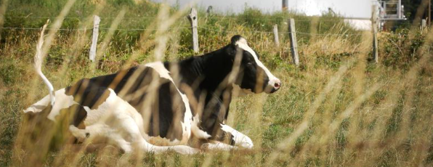
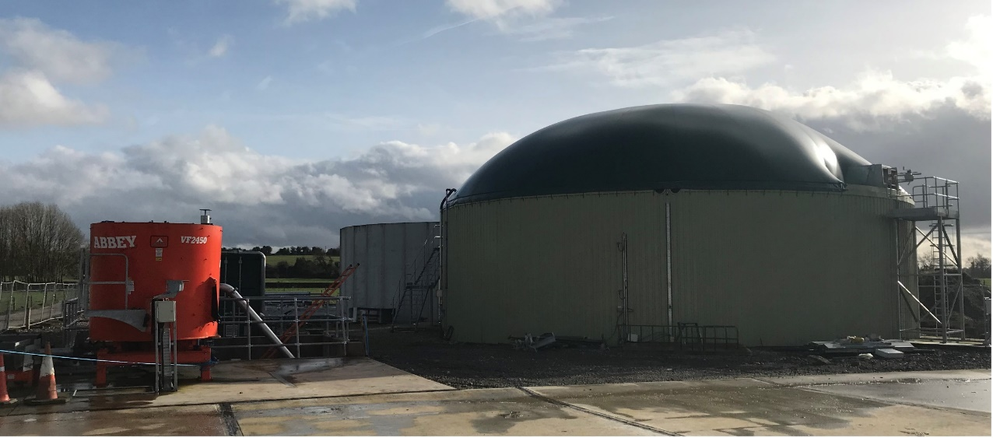
Grange anaerobic digestor
1 500m³ digestion vessel
  Pre-mixing of liquid & solid feedstocks
Biogas yield per year, 550 000 m³
Estimated total energy, 3 200 000 kWh
Final works and agreements ongoing
Feedstock | Grass silage | Slurry
Quantity (t/day) | 9.3 | 14.5
Biogas production | 84% | 16%
  Silage from 70 ha
  Slurry from 1,000 cattle
Centre of Excellence for AD Biomethane

Slide 11

FLEET : Farm Level Economic, Environmental and Transport modelling of feedstocks for AD (Teagasc Ashtown)
Economic modelling
  Quantify the potential costs and returns of farm based feedstocks for regional AD facilities
  Focus on grass silage, with particular attention to nitrogen requirement
  Assess the farm level willingness to accept various price levels for AD feedstocks
Environmental sustainability modelling
  Environmental assessment of supplying crops and manures as feedstock to a regional Anaerobic Digester
Transport modelling
  Using GIS methods to update national source-target assessment for the relevant biomass products and organic manures relevant to Anaerobic Digestion

Slide 12
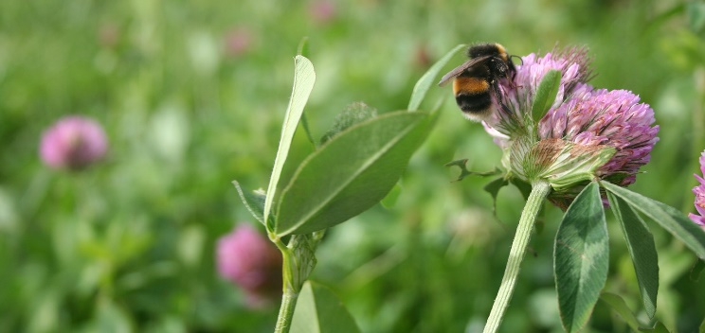
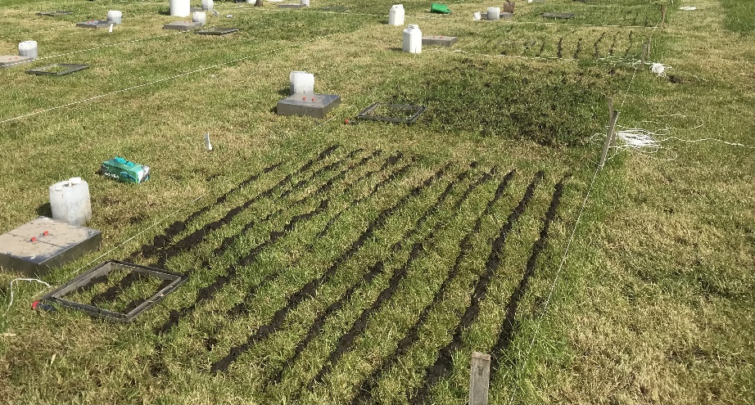
Summary
  Biomethane from anaerobic digestion of grass biomass provides an important opportunity to decarbonise the transport, heat and electricity sectors
  Key issues: environmental sustainability & economic viability
  Teagasc research is assessing the potential of alternative feedstocks, co-digestion and valorisation options
  Collaboration with key industry and research partners is a critical aspect of this research programme
  The Grange Anaerobic Digestion Plant is a key infrastructure to test and demonstrate farm level models of biogas production

Slide 13
Acknowledgements & other research areas
  Padraig O’Kiely’s Research Group, Teagasc Grange
  Peadar Lawlor, Teagasc Pigs Development Unit
  Gary Lanigan et al., Teagasc Crops Environment & Land Use Centre
  Ciara Beausang and Sofia Tisocco, Teagasc Animal & Grassland Research and Innovation Centre
  Fiona Thorne and Maurice Deasy, Teagasc Agricultural Economics and Survey Department
  Dominika Krol et al., Teagasc Crops Environment & Land Use Centre
  JJ Lenehan and David Wilson, Teagasc Building Officers, Corporate Services Department
  Vincent O’Flaherty and Xinmin Zhan, NUIG
  GNI, SFI and SEAI

