Slide 1
The voice of renewable gas in Europe
BIOGENIC CO₂ FROM THE BIOGAS INDUSTRY: Introduction to a business opportunity that will enhance circularity and climate benefits of biogas production
4th REGATRACE Event - Dublin
Anthony Lorin – Policy Officer
lorin@europeanbiogas.eu

Slide 2
Agenda
I | Why biogenic CO2 from Anaerobic Digestion? Advantages Technology Volume potential
II | Potential markets for bio-CO2 from Anaerobic Digestion
III | Exemplary use cases
IV | How to enable the uptake of bio-CO2 from AD? Regulatory barriers to be addressed

Slide 3
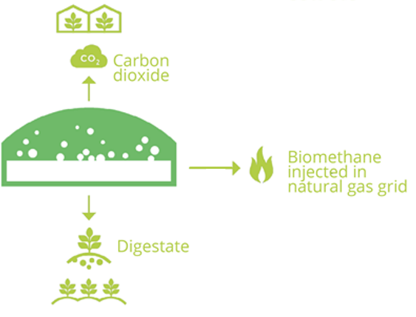
I - Why biogenic CO2 from Anaerobic Digestion?
Contributing to environmental objectives thanks to a local concentrated source of bio-CO2
Climate change mitigation
Enhancing the climate benefits of biomethane production with substitution of fossil CO2 by biogenic CO2
Circular economy (resource-efficiency)
Recycling CO2 with local value chains
Bioeconomy
Sustainable provision of carbon for food and feed, energy and materials
Highly concentrated source from biogas upgrading | Up to ± 99% (10% max in the flue gas of biomass-fired power generation plants)
Regatrace 4th event in Ireland – 01 June 2022

Slide 4
I - Why biogenic CO2 from Anaerobic Digestion?
Mature technologies
Technologies are mature | Biogas upgrading Purification of CO2 Liquefaction of CO2 Available purification and liquefaction processes capable of generating a liquefied CO₂ that is fully compliant with the most stringent CO2 quality requirements. Several European companies can provide all these purification technologies as well as CO₂ liquefaction units. They are exporters and world leaders in innovation in this field.
Easy access | A co-product of the fast-growing energy
Regatrace 4th event in Ireland – 01 June 2022

Slide 5
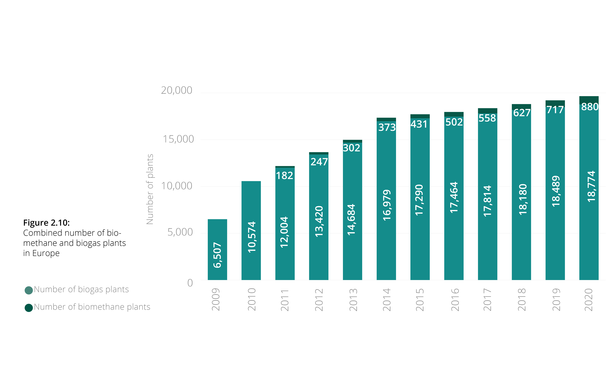
I - Why biogenic CO2 from Anaerobic Digestion?
Significant volumes – Theoretical production based on figures from 2020 (1/2)
880 biomethane plants 3.9 Mt biogenic CO2/year were produced
18,774 biogas plants 24 Mt biogenic CO2/year potential (if all biogas was upgraded)
The biogas and biomethane industry in Europe
Regatrace 4th event in Ireland – 01 June 2022

Slide 6
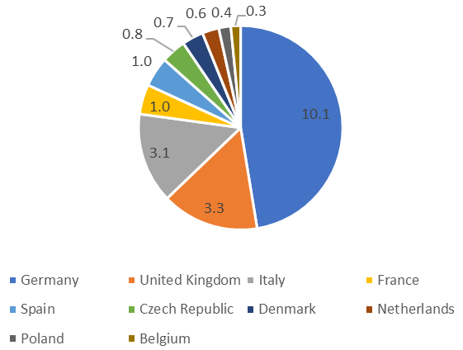
I - Why biogenic CO2 from Anaerobic Digestion?
Significant volumes – Theoretical production based on figures from 2020 (2/2)
Potential biogenic CO2 (Mton) if AD plants would fully upgrade to biomethane, with respect to the combined biogas and biomethane production in 2020
Regatrace 4th event in Ireland – 01 June 2022

Slide 7
I - Why biogenic CO2 from Anaerobic Digestion?
Significant volumes – Potential of production in 2030 and 2050
 | Biogas and biomethane production in Europe | Theoretical potential of biogenic CO2 | Comparison with existing markets
2020 | 18 bcm | 24 Mton
2030 | 35 bcm | 46 Mton | 86 Mton EU demand for chemicals and plastics (2018)
2050 | 95 bcm | 124 Mton | 256 Mton EU demand for food and feed plastics (2018)
Regatrace 4th event in Ireland – 01 June 2022

Slide 8
II - Potential markets for bio-CO2 from Anaerobic Digestion
Gaining a share in existing CO₂ markets
Greenhouses
Food and beverage
Refrigeration
Geographically distributed like AD plants
Local supply for farmers
Price stability for farmers
Secured supply and/or exclusivity conditions
But significant seasonality
Very high purity required
Possible uses: packaging (as a preservative agent); carbonation of soft drinks, mineral water and beer; production of deoxygenated water; use of CO₂ as acidifier
Bio-CO2 as an alternative to fluorinated gases (F-gas)
Regatrace 4th event in Ireland – 01 June 2022

Slide 9
II - Potential markets for bio-CO2 from Anaerobic Digestion
Potential CO₂ markets in the future
Renewable fuels (Power to gas)
Converting H2 into synthetic methane to transport in existing networks without retrofitting anything
Polymer manufacturing
Direct integration of CO2 in the chemical structure or integration by hydrogenation of CO2
Inert gas in a European semiconductor industry
Ultra-high purity cleaning agent
Algae/Micro-algae culture
Power-to-Gas technology optimises the integration of renewable electricity into the overall energy system
Use of algae/micro-algae for production of biofuels or chemical compounds
Building materials
Concrete curing
Mineral recycling: chemical reaction with mineral waste such as coal fly ash, steel slag, cement-kiln dust, bauxite residue and mine tailings
Stable sequestration of CO2 in materials
Bio-CO2 as a biological input to microalgae used as a tertiary biotreatment of wastewaters
Regatrace 4th event in Ireland – 01 June 2022

Slide 10
III - Does it work in practice?
Existing anaerobic digestion plants implementing CCU of biogenic CO2
13
AD plants implementing CCU of biogenic CO2 in Europe in 2021 (8 in the EU-27)
6
Of them produce food-grade CO2
7
Different European countries (France, Germany, Ireland, Italy, Norway, Switzerland, UK)
Regatrace 4th event in Ireland – 01 June 2022
Notes:
Metha Treil is located in Loire-Atlantique, western France, and specialises in the production of gaseous fuels. SAS Metha Treil brings together farmers and market gardeners on an anaerobic digestion unit, where three farms provide inputs for AD, and at least one of the two market gardeners uses CO2 for the growth of its greenhouse crops. The anaerobic digestion plant includes, among other technology, two 1,800 m³ digesters, that are fed by livestock effluents, silage from cover crops or corn and vegetable by-products. Biomethane upgrading is carried out using membrane filtration technology. The bioCO2 recovery process recovers the lean gas at the outlet of the upgrading module, and through a succession of thermodynamic and physical operations, isolates the CO2 in the liquid phase. 1500 ton/year of CO2 are produced. The CO2 is stored in a vertical tank, before being transported, once or twice a week, to the greenhouse site in Saint-Philbert-de-Grand-Lieu.
The biomethane plant in Korskro, Denmark is under operation since 2019. It processes about 500,000 tons of biomass annually, of which around 75% is manure and litter from cattle, pigs, and minks. This plant recently upgraded its production size and added a carbon capture unit. The total capacity of biomethane production increased from 22 million m³ (in 2019) to 49 million m³ biomethane. The CO₂ separated in the biogas upgrading process is now captured and processed. After purification, the biogenic CO₂ is used in the food industry and beyond. Annually 16,250 tons of bio-CO₂ is captured and utilised, which is equal to 25% of the Danish CO₂ demand.

Slide 11
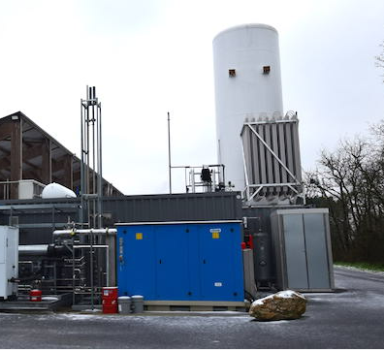
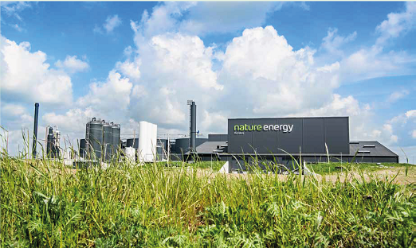
III – Does it work in practice?
Exemplary use cases
Métha Treil – France (near Nantes)
Feedstock: livestock effluents, vegetable residues, secondary crops
Production: 1500 ton/year biogenic CO2
CO2 use: local greenhouses
Korskro biogas plant - Denmark
Feedstock: manure
Production: 16.25 kt/year biogenic CO₂
CO2 use: food and beverages industry
Greenville plan – Northern Ireland
Co-production of liquid CO2 since 2019
Feedstock: crop residues, food waste and livestock effluent
Production: 5 ton/day biogenic CO2
CO2 use: dry ice
Regatrace 4th event in Ireland – 01 June 2022
Notes:
Metha Treil is located in Loire-Atlantique, western France, and specialises in the production of gaseous fuels. SAS Metha Treil brings together farmers and market gardeners on an anaerobic digestion unit, where three farms provide inputs for AD, and at least one of the two market gardeners uses CO2 for the growth of its greenhouse crops. The anaerobic digestion plant includes, among other technology, two 1,800 m³ digesters, that are fed by livestock effluents, silage from cover crops or corn and vegetable by-products. Biomethane upgrading is carried out using membrane filtration technology. The bioCO2 recovery process recovers the lean gas at the outlet of the upgrading module, and through a succession of thermodynamic and physical operations, isolates the CO2 in the liquid phase. 1500 ton/year of CO2 are produced. The CO2 is stored in a vertical tank, before being transported, once or twice a week, to the greenhouse site in Saint-Philbert-de-Grand-Lieu.
The biomethane plant in Korskro, Denmark is under operation since 2019. It processes about 500,000 tons of biomass annually, of which around 75% is manure and litter from cattle, pigs, and minks. This plant recently upgraded its production size and added a carbon capture unit. The total capacity of biomethane production increased from 22 million m³ (in 2019) to 49 million m³ biomethane. The CO₂ separated in the biogas upgrading process is now captured and processed. After purification, the biogenic CO₂ is used in the food industry and beyond. Annually 16,250 tons of bio-CO₂ is captured and utilised, which is equal to 25% of the Danish CO₂ demand.

Slide 12
IV - How to enable the uptake of bio-CO2 from AD?
Regulatory barriers to be addressed
1
Creating a market for biogenic CO2 by giving it economic value for its environmental benefits
2
Accelerating the uptake of biogenic CO2 by setting up demand-side drivers
3
Recognising the environmental value of bio-CCU value chains in the sustainable finance framework
Recognition in the accounting of CO2 emission avoidance
ETS sectors
Non-ETS sectors
A target - Obliging an increasing share of biogenic in the industrial consumption of CO2
Bio-CCU value chains based on anaerobic digestion and biomass gasification
Should be recognized in the Taxonomy of sustainable activities
A rule - Compulsory disclosure of the origin (fossil / biological) of the CO2 used in products, including beverages (visibility and differentiation from fossil value chain)
A European carbon removal certification framework enabling the reliable issuance and trade of carbon removal credits
Ensuring that biomethane plant operators are rewarded for the co-production of biogenic CO2.
Pricing - Biogenic CO2-derived (motor or heating) fuels should have preferential tax treatment
Regatrace 4th event in Ireland – 01 June 2022

Slide 13
Conclusion: Next steps for the EBA’s work
Publication of the Biogenic CO2 White Paper (end of June 2022)
Advocacy effort on the legislative framework
Identifying the best business models
Raising awareness among industrial end-users
Indicative timeline and blocks
Regatrace 4th event in Ireland – 01 June 2022

