Slide 1


VISIONGREEN
CONSULTANCY
Decarbonising the Transport (HGV) Sector
Wednesday, 01 June, 2022
visiongreenconsultancy.ie

Slide 2


Who are we?
Co Founders
Ronan Murphy
John Pakenham
Purpose driven sustainability consultancy business founded in 2018
Concept Logistics business founded in 2020
Projects to date have delivered a reduction of 5,354 tonnes of c02 emissions in Ireland

Slide 3



Our products and services
Carbon Assessment
Sustainable Transport Solutions
Green Grant Support

Slide 4
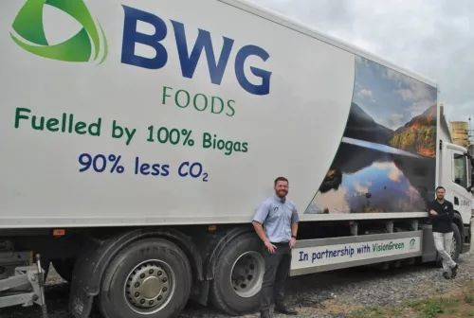
First Movers
In partnership with BWG Foods / Spar group and Green Generation Ltd, VisionGreen Logistics Solutions Ltd was the ﬁrst Logistics company in Ireland to make retail deliveries on gas powered vehicles fueled with Biomethane.
The Biomethane was generated from food waste from BWG Foods Distribution centre making it a circular economy solution for Ireland.
Concept initiative to demonstrate what can be done to reduce emissions in Transport in Ireland.

Slide 5










Our clients and partners

Slide 6
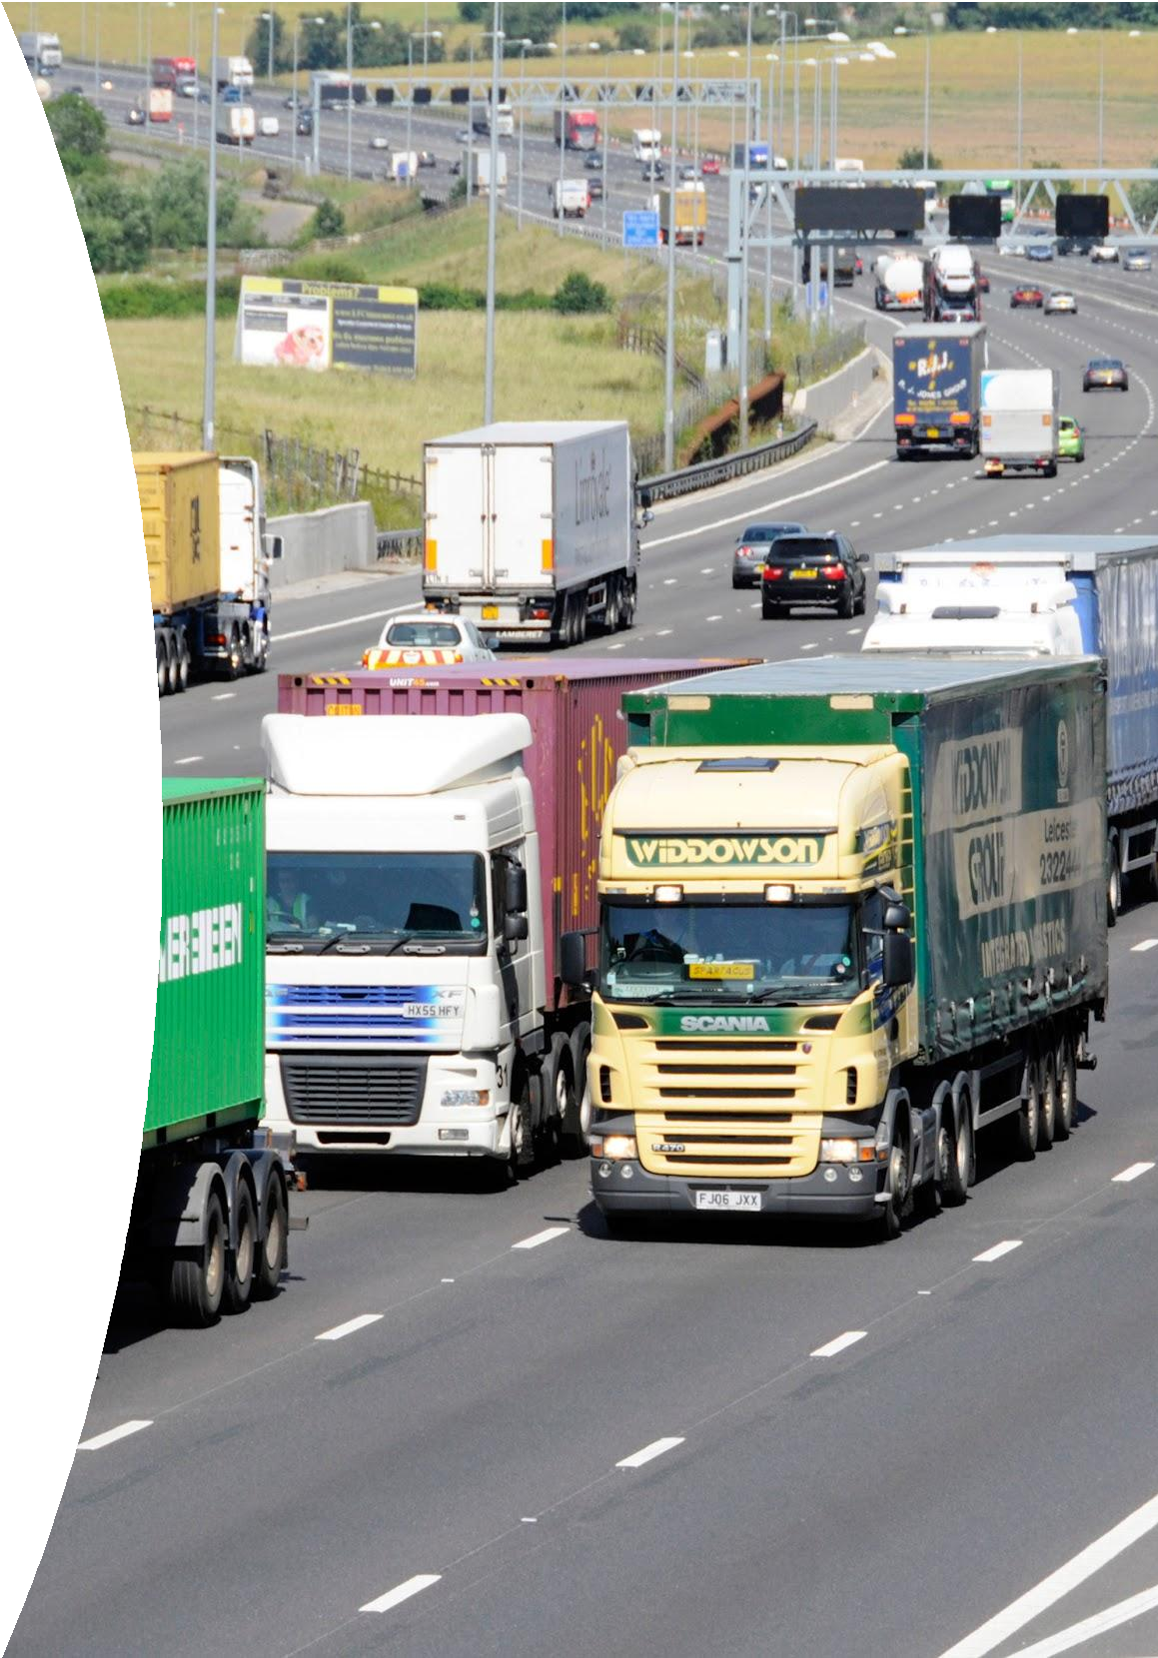
TRANSPORT IN IRELAND STATE OF PLAY
Transport Sector Emissions
Transport sector accounts for circa 20% of Ireland's emissions annually.
Transport remains almost entirely (97%) dependent on fossil fuels (SEAI, 2020).
HGV’S & buses account for 4% of vehicles on the road but produce 30% of Transport emissions in Ireland(GNI Vision 2050).
Heavy Goods Vehicle (HGV) freight second largest use of transport energy outside of aviation at 19%.
Policies and Targets to Address
European Green Deal (EU) - Emissions reduction target 55% by 2030; net zero by 2050.
National Energy & Climate Plan 2021-30 (IRL) - 7% annual average reduction in greenhouse gas emissions between 2021 and 2030.
Climate Action Plan 2019 (IRL)
- Carbon Tax to increase to €100 per tonne by 2030 and €265 by 2050.

Slide 7
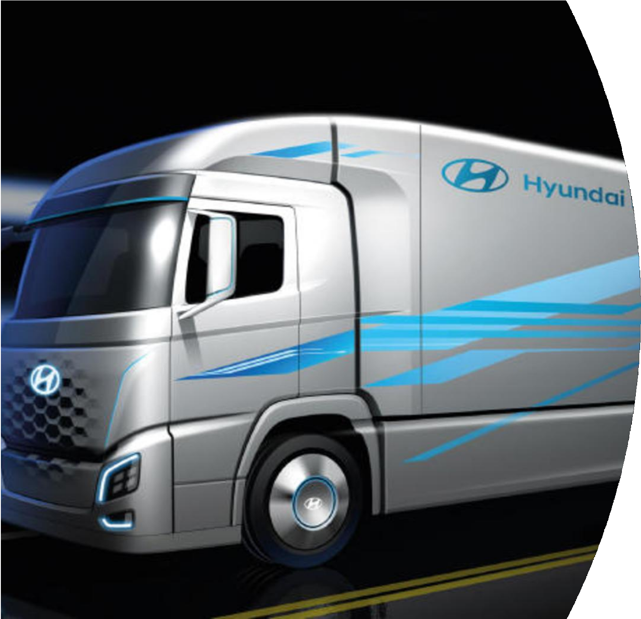
Heavy Duty Alternatives to Diesel
Electric Trucks
Electric trucks 3-4 times more expensive than diesel.
Limited range 150 km (120 km real world data ).
Scarcity of fast-charging infrastructure - loss of operating times.
Heavy weight of batteries - loss of load capacity.
Low manufacturing volumes.
Hydrogen Trucks
Still very much a concept.
Hydrogen production is energy intensive and expensive.
  Will require renewable production to increase exponentially.
Both Electric & Hydrogen at early development stage, and far from being commercially viable for at least another
5-10 years

Slide 8
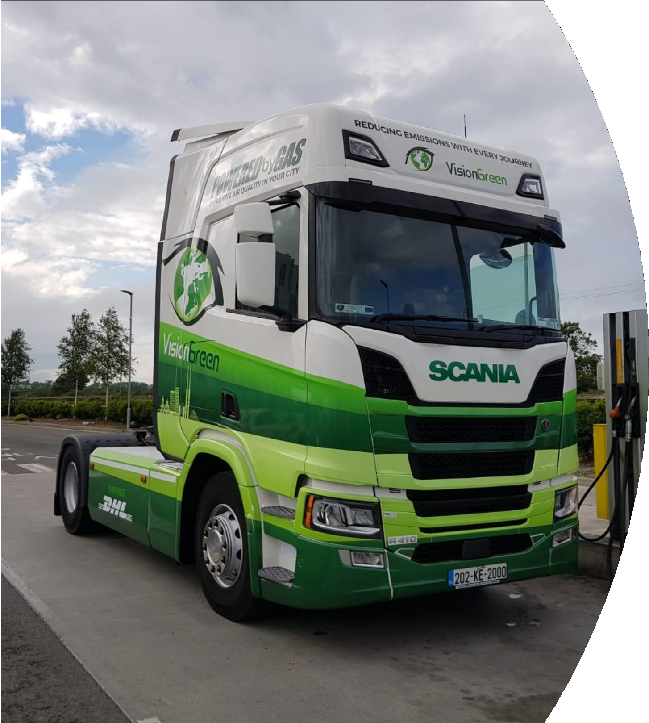
Heavy Duty Alternatives to Diesel - Gas Powered Vehicles
20% less emissions vs diesel with CNG
90% less emissions than diesel with Biomethane
Refueling infrastructure limited but developing
Similar range to diesel vehicles
With exception of current global issues cost per kilo vs diesel has been very competitive over last 5 years
Vehicle purchase grants available to support transition
Active solution on Irish roads as we speak

Slide 9
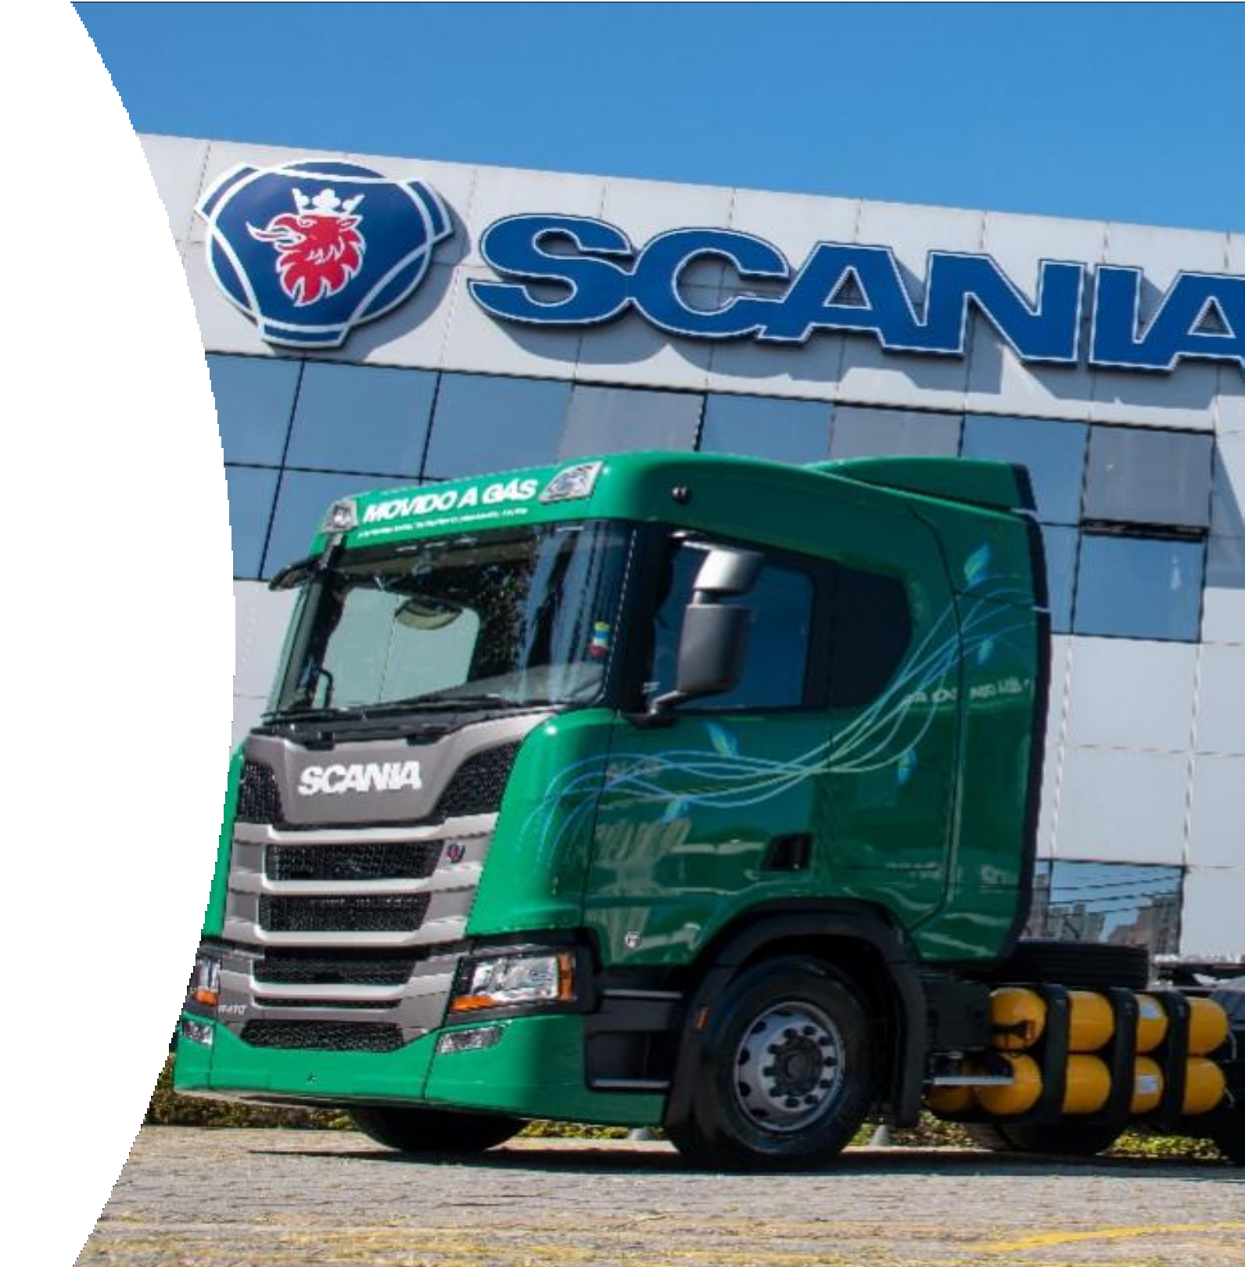
Comparison: Alternative Fuel
Biomethane
Renewable gas.
  Capturing methane from waste.
Extremely clean - 90% less emissions than diesel potential to be carbon positive if CO2 captured.
Compatible with existing gas-run trucks.
EU 27 members like Denmark and Sweden have prioritised policy in supporting Biomethane production.
  Helping them to decarbonise Transport and Heat, lowest emitters in Europe.
Electricity
Renewable but emissions footprint varies by source.
Manufacturing emissions have been estimated as high as double that of diesel.
Ireland electricity grid already 65% dependent on gas.
  Electriﬁcation of Transport will require higher sources of renewables.

Slide 10

Challenges
Geopolitical issues (Ukraine) driving up cost of gas and causing increased vehicle delivery lead times for new units.
Roll out of public and private fueling infrastructure has been slow to date - Only four public CNG Fueling stations on the island.
Process of commissioning fueling infrastructure with regulator has led to delays on several sites.
Lack of public awareness of the beneﬁts of Biomethane production through Anaerobic Digestion in Ireland.
Lack of government support for Anaerobic Digestion industry in Ireland to date.
Currently only one plant in Ireland producing Biomethane for grid injection.

Slide 11
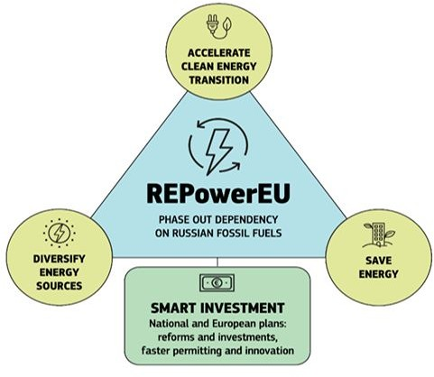
Opportunities
REPowerEU
EU Energy Platform - to enable voluntary common purchases of gas, LNG and hydrogen.
EU External Energy Strategy - to facilitate energy diversiﬁcation and building long-term partnerships with suppliers, including hydrogen or other green technologies.
Biomethane Action Plan - to set out tools including a new biomethane industrial partnership and ﬁnancial incentives to increase production to 35bcm by 2030, including through the Common Agricultural Policy.
(European Commission, 2022)

Slide 12
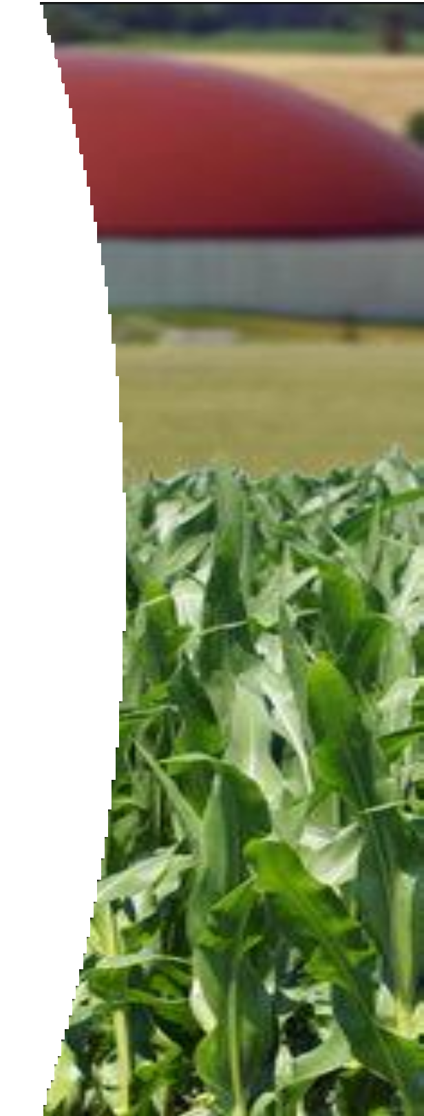
Next Steps & opportunities
Development of an indigienous AD Biomethane industry in Ireland to support reducing emissions and improve fuel security.
Extend the treatment of excise duty on gas (set to expire Dec 24).
Review potential to remove toll charges for gas powered vehicles.
Provide additional grant support and tax relief to stimulate purchase and uptake of gas powered HGV’S.
Streamlined planning and commissioning process with the regulator for CNG fueling infrastructure.
Capital support to accelerate roll out of fueling infrastructure in Ireland.
Education and awareness of the beneﬁts of AD Biomethane as a renewable fuel for Transport in Ireland.
Industry, sectoral & government collaboration to support driving forward the use of Biomethane for Transport in Ireland.
Conﬁdence in innovation & technology and our ability as a nation to meet this challenge.

Slide 13
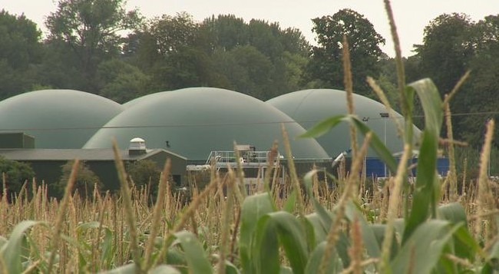


T H A N K S F O R Y O U R T I M E
www.visiongreenconsultancy.ie

