Slide 1
The voice of renewable gas in Europe
IRELAND BIOMETHANE CONFERENCE 2022
Harmen Dekker, CEO of the EBA
dekker@europeanbiogas.eu

Slide 2
The EBA in a nutshell…
44 national biogas associations
187* organisations representing the whole biogas and biomethane value chain.
*As of October 2022
The EBA is striving to maximise biogas and biomethane production and consumption across Europe in all end-uses, including transport, buildings and industry.
Representing the biogas industry in Brussels since 2009.
37 countries in Europe and beyond and over 8,000 stakeholders covering the whole biogas and biomethane value chain.

Slide 3
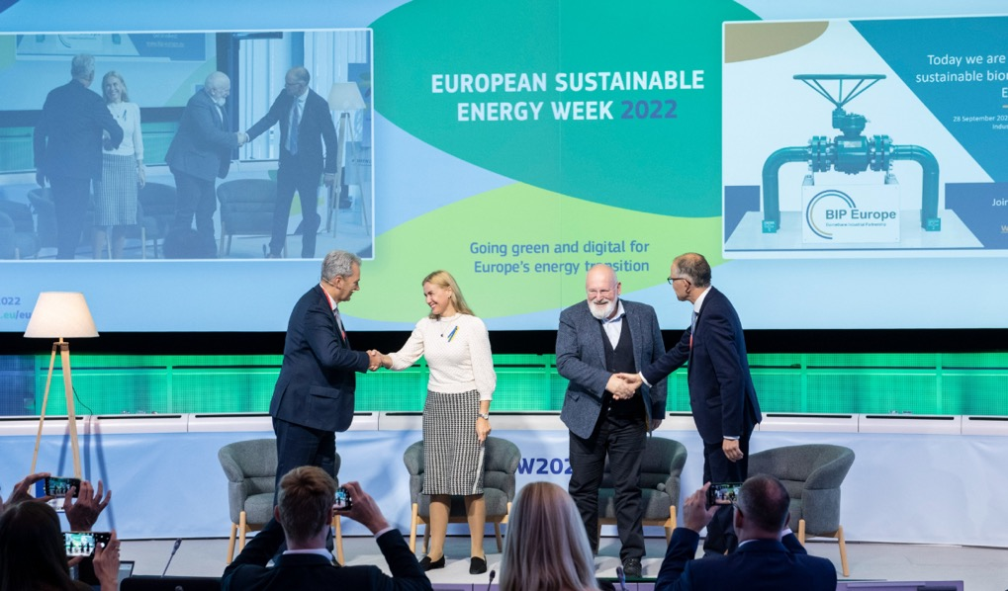
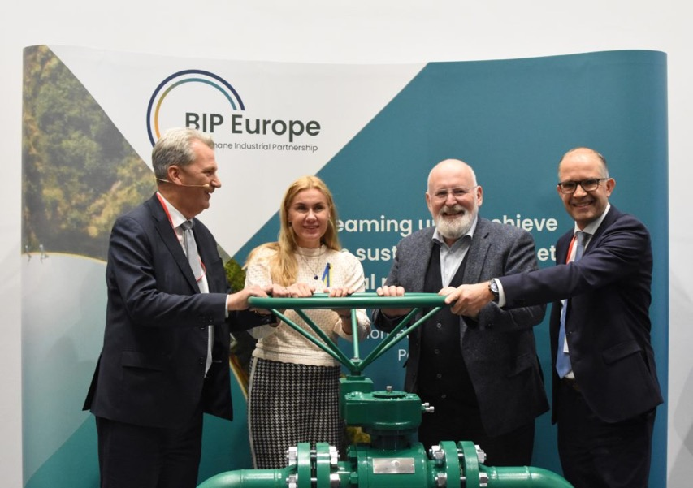
REPowerEU target: 35 bcm of sustainable biomethane 2030
Biomethane Industrial Partnership
A partnership between EC / MS /value chain / Civis society / Academia

Slide 4
The value chain is already working to turn the 35 bcm into reality

Slide 5
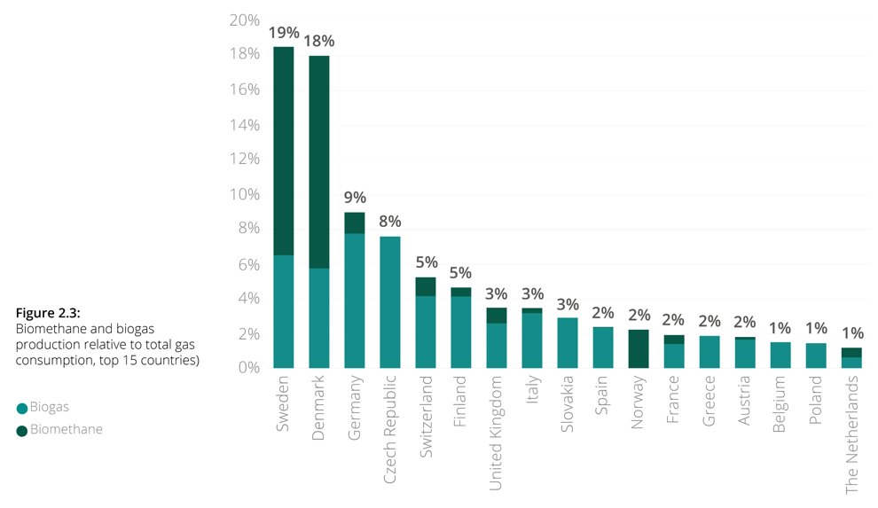
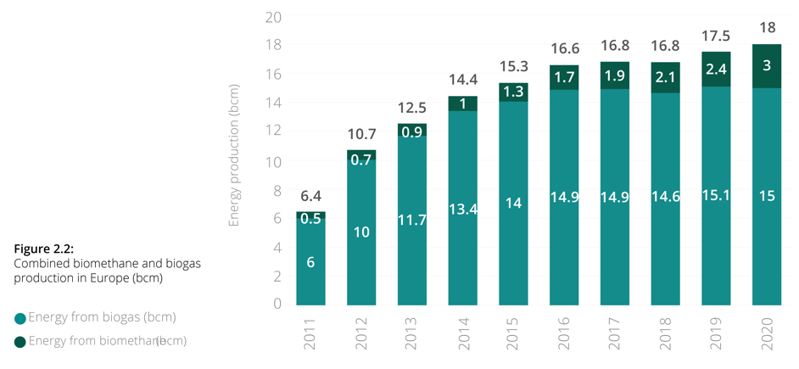
Biogas and biomethane production today
Current production
Europe was producing end of 2020 18 bcm (15 bcm of biogas and 3 bcm of biomethane) from 19,654 plants.
Relative to gas consumption
4.6% of EU gas consumption = Close to entire natural gas consumption of Belgium
Source: EBA Statistical Report 2021
Source: EBA Statistical Report 2021
Notes:
Example gas grid injection: Denmark has reached this year 25% of biomethane share in the gas grid

Slide 6
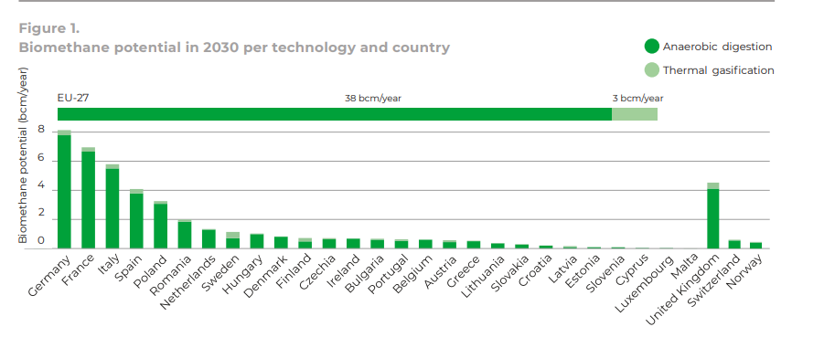
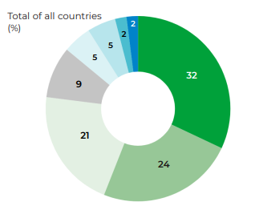
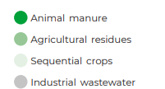
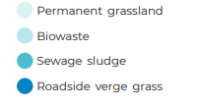
Biomethane pot. in 2030 sufficient to meet the 35bcm target
Feedstock potential (all countries)
Source: Biomethane production potentials in the EU – GfC 2022

Slide 7
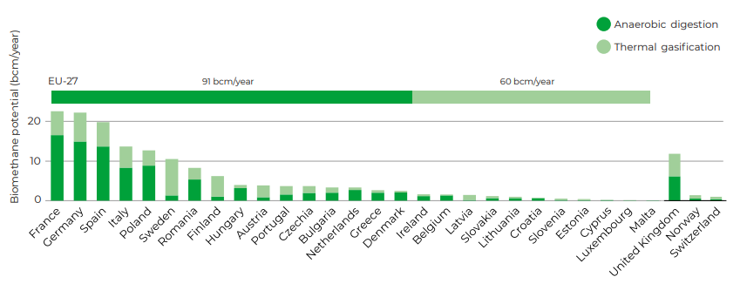
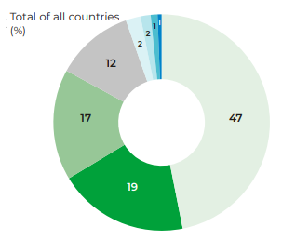
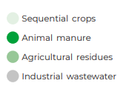
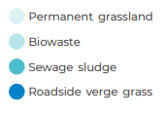
The sector can expand production up to 151 bcm by 2050
2050 national biomethane potentials: Gas for Climate 2022
Feedstock potential (all countries)
The EU-27 countries with the highest potentials in both 2030 and 2050 are broadly similar and include France, Germany, Italy, Spain and Poland
Notes:
France is experiencing a fast expansion of biomethane production
Italy just published a biomethane decree

Slide 8
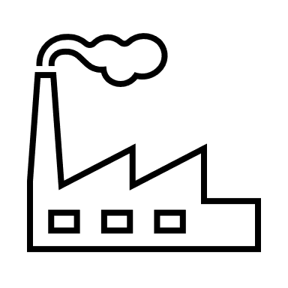
Supporting the defossilisation of the EU Economy with biomethane
We can replace natural gas with biomethane for the decarbonisation of buildings with hybrid heat pumps.
The possibility to use existing infrastructure provides comfortable adaptation of households to sustainable choices and is financially attractive for users.
Biomethane provides high temperature heat and climate neutral carbon for industrial processes.
There is increasing interest from industry users on the deployment of biomethane right now as a means to decarbonise their industries.
The future power system requires dispatchable power. Biomethane provides flexibility and high value.
Biomethane can be easily stored and produced at a constant pace, helping balance energy supply from intermittent energy sources of renewable origin, such as solar or wind.
Decarbonisation of maritime and heavy long-distance road transport
Europe will have 78 bio-LNG plants by 2024 producing 10.6 TWh of this renewable fuel.
This would allow for the equivalent of 25,000 LNG trucks to be fueled year-round.

Slide 9
Producing organic fertilisers and using biogenic CO2 as feedstock
Digestate and carbon storage
Digestate offers an alternative to commonly used synthetic fertilisers.
We can store in the soil 50 to 80% of carbon from digestates used as organic fertiliser. The EU is largely dependent on imports for most of synthetic fertilisers and 30% of them come from Russia.
Carbon capturing and use of biogenic CO2 as feedstock
The sector is a real opportunity for the exploitation of the biogenic CO2 market. From 1 ton of biogas we obtain almost 2 tons of biogenic CO2. If all CO2 from the biogas industry was captured and stored…
Biogas and biomethane production in Europe
18 bcm today
35 bcm by 2030
95 bcm by 2050
Biogenic CO2 obtained
24 Mton
46 Mton
124 Mton
Biogenic CO2 can be used in…
Greenhouses
Beverage industry
Green hydrogen
Notes:
Digestate offers an alternative to commonly used synthetic fertilisers. Through the recycling of organic matter in anaerobic digestion plants, digestate contains all the nutrients (and micronutrients) necessary for farming. Digestate has the potential to meaningfully contribute to carbon storing in agriculture. We can store in the soil 50 to 80% of carbon from digestates used as organic fertiliser
CO₂ is one of the most useful industrial gases we have and the disruption in the CO₂ supply chain is starting to hit many industries across Europe.
CO2 as feedstock is mainly obtained from the production of synthetic fertilisers, which is highly energy-intensive. The production of synthetic fertilisers has plummeted due to the elevated gas price and CO₂ is becoming harder to find, which causes a price hike.
The production of biomethane can increase CO₂ supplies in Europe and alleviate the pressure on these industries and, ultimately, on final consumers.

Slide 10
IMPACT OF UPCOMING LEGISLATION
Sustainable Carbon Cycles
Sequential crops
REDIII – Annex IX and VI
FIT for 55 Package
WFD
UWWTD
FPR Revision
Soil Health Law
Source EBA Statistical Report 2021

Slide 11
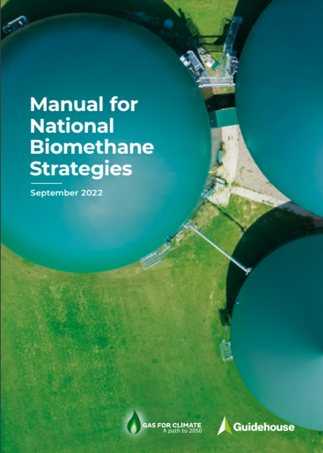
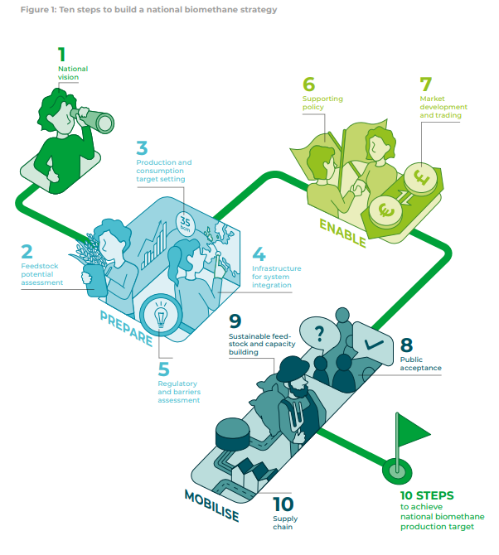
Efforts at national level are also needed
The EU’s 35 bcm biomethane target for 2030 has to be translated into individual contributions by all member states.
The European Commission published a Biomethane Action Plan setting out measures to be taken at both national and European levels to scale up biomethane production and consumption.
The plan includes a recommendation to member states to develop a national biomethane strategy as soon as possible.
Gas for Climate has compiled this step-by-step manual to support member states in developing and implementing their national biomethane strategies.

Slide 12
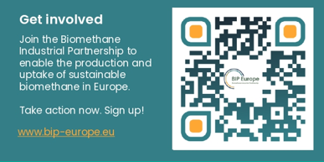
THANK YOU!
Harmen Dekker, CEO of the EBA
dekker@europeanbiogas.eu
Re-thinking our economy. Making the energy transition happen.
www.europeanbiogas.eu
Follow us on

