Slide 1
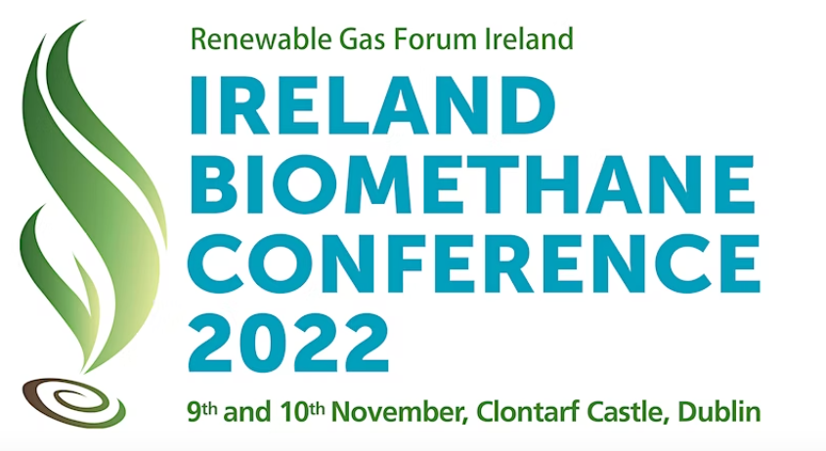

Slide 2
“We are on the Highway to Climate hell with our foot on the accelerator….”, UN Secretary-General, Antonio Manuel Cop27
Monday Night Live, Climate piece on RTE, Orla Murphy, “you can see in this room here, we are talking about the climate crises, the biggest issue ever faced, and we are just squabbling….”

Slide 3
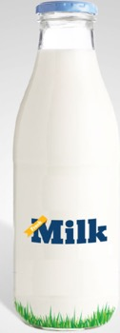
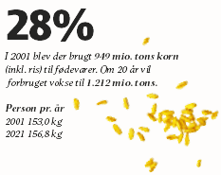
Expected increase in global consumption increase
The global challenges
(CAGR 2022-2027)
5.48%
23%
Cheese
How to provide food & energy for 9 Billion people?
And can we make it sustainable?
Can we
increase the land area for food production?
increase agricultural productivity/yields? = more fertiliser (NPK), moreover can we replace existing fertiliser with organic alternatives?
produce alternative green energy?
…..while limiting environmental impacts?
Cereals
incl. Rice

Slide 4
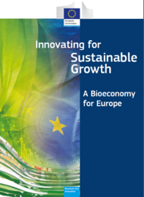
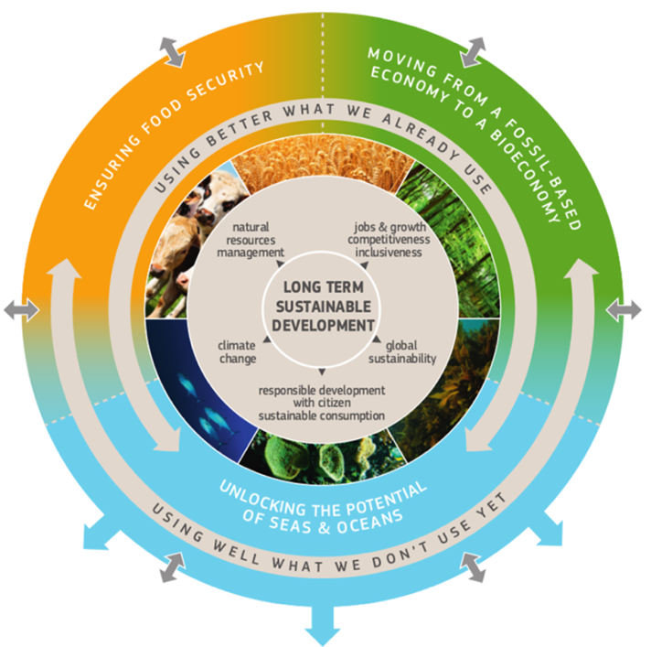
The European Bioeconomy Strategy
Context for EU bioeconomy strategy
Communication on Bioeconomy – 2012
Food security, sustainable management of natural resources, climate change, reduced fossil-dependence, jobs creation and EU competitveness
Review of Bioeconomy Strategy – 2017
good delivery, objectives still relevant, increasing importance, more focussed actions for evolved context (SDGs, circular economy,)
Updated Bioeconomy Strategy – 2018
Co-ordination by the Secretariat General and DG Research together with departments for agricultural, environment, marine, industry, energy and others (DGs AGRI, ENV, MARE, GROW, JRC, ENER…)

Slide 6
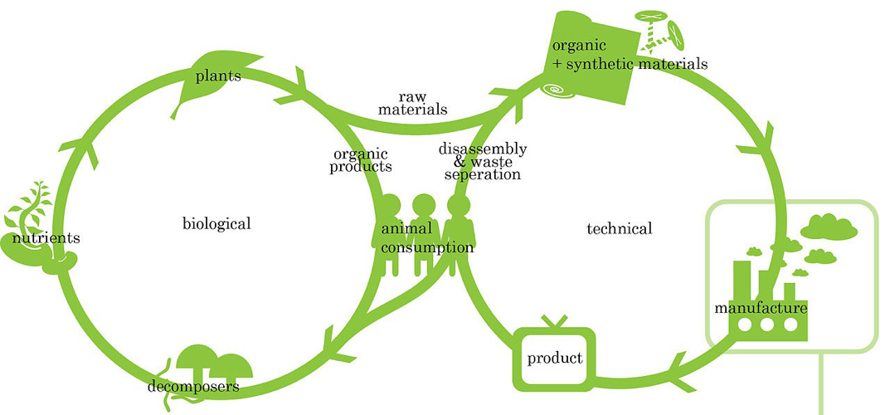
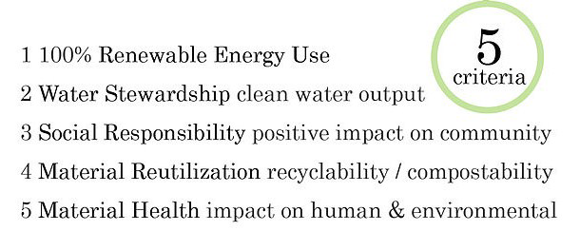
Cradle-to-Cradle concept

Slide 7
The bio-economy – circular economy story …
Recycling
The HOOK!
AD Treatment
Products
(food, fertiliser, energy)
Monitoring

Slide 8
Closing the loop - An EU action plan for the Circular Economy
EC - Phosphorous designated a CRITICAL RAW MATERIAL
Legislative proposal Revised Fertiliser Regulations (Dec 2019) to create a single market for fertilisers made from secondary raw materials (in particular recovered nutrients), thereby turning waste management problems into economic opportunities.
less dependent on imports of critical, primary raw materials such as phosphate,
Regulation provides rules for free movement of all CE-marked fertilising products across the EU, including for organic fertilising products
The HOOK!

Slide 9
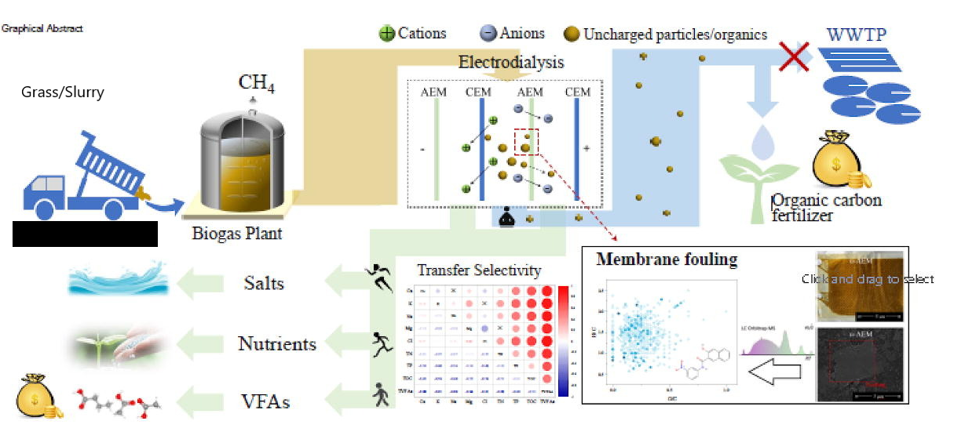
Closing the loop - An EU action plan for the Circular Economy
The HOOK!

Slide 10
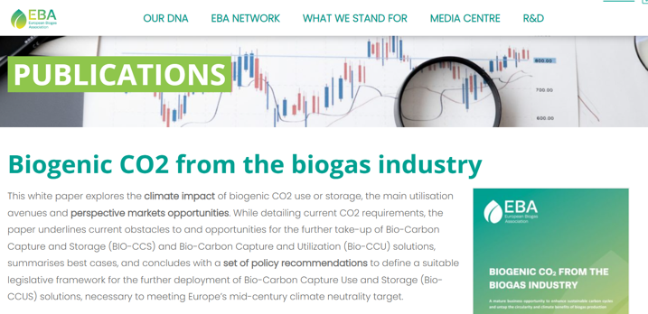
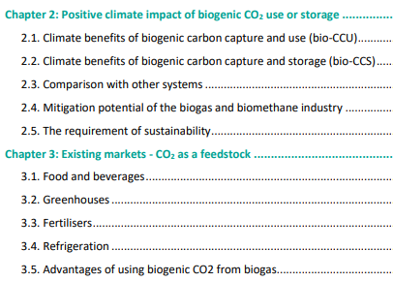
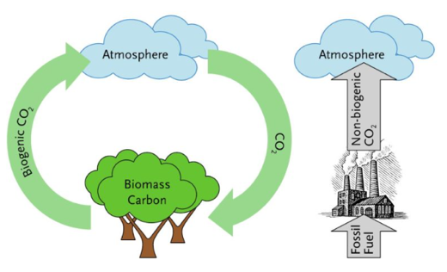
Closing the loop - An EU action plan for the Circular Economy
The HOOK!

Slide 11
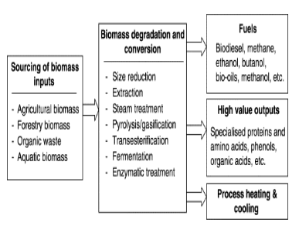
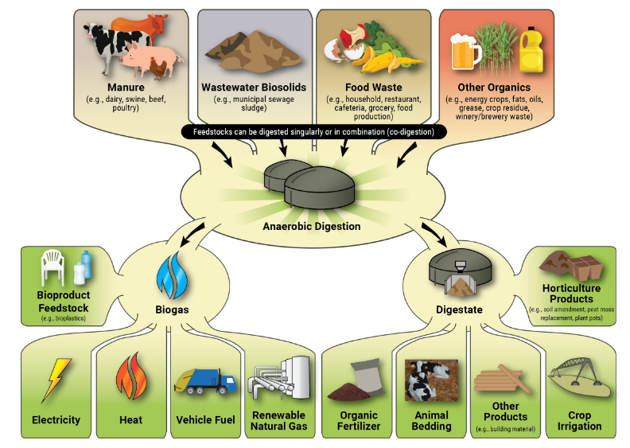
An overview of factors influencing biomass inputs, process intermediates, conversion technologies and possible products and energy streams obtainable defined as a biorefinery set-up

Slide 12
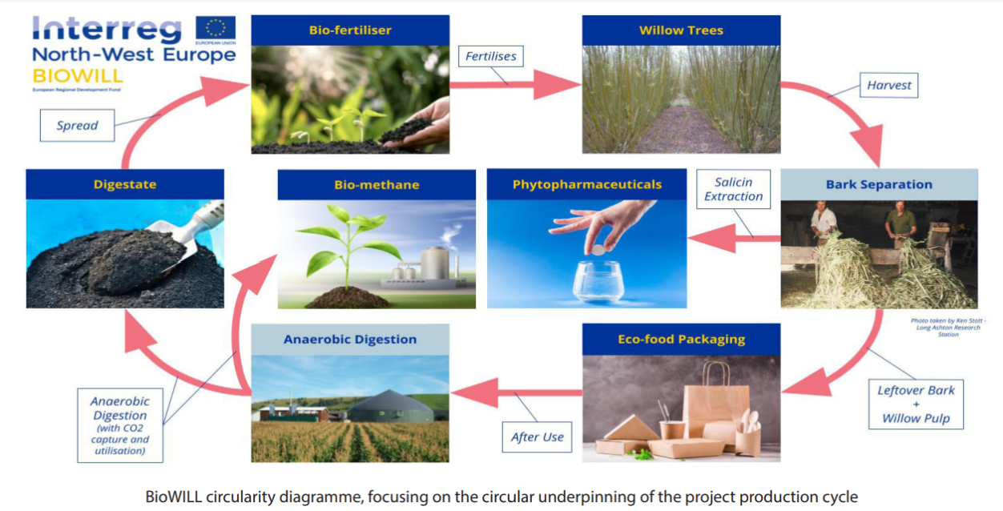
Closing the loop - An EU action plan for the Circular Economy
The HOOK!
The HOOK!
The HOOK!

Slide 13
Anaerobic Digestion is not only about biomethane…. It is a lot more!!!!..... The circular economy, the environmental benefits, the future of farming, rural regeneration, carbon offset, sustaining indigenous sectors, social and economic responsibility …..It’s a foot to the brake of Climate Change!

