Slide 1
Biomethane Conference
November 2022

Slide 2
INTRODUCTION
An industry forum representing the full supply chain of renewable gases.
Our Purpose - to be Ireland’s national co-ordination and design authority for AD biomethane as a key enabler of the emerging bio economy.
We advocate on behalf of energy gas consumers for an integrated system, with solutions to decarbonise energy intensive processing industries such as Agriculture, Heat and Transport.
Members include: industrial gas consumers in the manufacturing and processing (food) sectors; AD developers / operators; farmers; community organisations, public agencies, shippers, and academics.
National representation
- instrumental in designing and establishing the Green Gas Certification Scheme for Ireland
- project Co-ordinator of the 2019 KPMG Vertically Integrated Business Case for Biomethane
- Co-Ordinator for Sectoral Representation e.g., dairy industry collaboration, Project Clover.

Slide 3
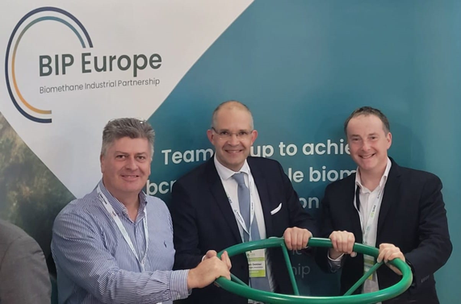
EUROPEAN REPRESENTATION
RGFI
Board of the European Biogas Association (EBA)
Chair of National Associations Platform – member of the Sustainable Biomethane Alliance
Board Member of the European Renewable Gas Registry (ERGaR)
Lead partner for REGATRACE in Ireland - collaborating with public and private stakeholders to develop an agreed vision and roadmap for biomethane in Ireland since 2019.

Slide 4
NATIONAL AMBITION
Industry level of ambition is 2.5TWh by 2030 and 9.5TWh by 2050
Government target of 5.7TWh biomethane
Capital Funding requirements €1bn at 2.5TWh, €2.5bn at 5.7TWh
RHO - to be Implemented by 2024.
Dedicated Biomethane Fund of €200m with Fund Manager appointed to make investment decisions
Submission to DAFM and DECC for 20 AD biomethane plants with €100m Capital Funding to end 2025.
Target for 110 AD biomethane plants between 2026 and 2030 - Capital Funding of €550m.
To meet this ambition requires ..
National co-ordination – RGFI continued role
Feedstock mobilisation, planning, permitting.

Slide 5
Current Measures
GreenGas Cert for Ireland / compliance with REDII
Grid Connection Agreement – supportive and favourable to biomethane
Harmonisation of Tariffs – priority given to biomethane and competitive rates
GNI formally appointed under SI in July’22 as the “National Issuing Body”
Integrated Business Case for Biomethane production in Ireland
Agricultural feedstock based AD biomethane system
768’k Ha of under utilised pasturelands
Emissions reduction of 800’k t/CO2 pa by 2030
Farmer Centric
Dedicated Commercial Waste Biomethane plants
Up to 50% of commercial biodegradable materials exports
Support existing AD operators
Economic end -use of Biomethane
Thermal Heat demand
Transport HGV

Slide 6
RePower EU – HOW IRELAND ALIGNS
Policy pillars | Ireland opportunity
1. Feedstock Mobilisation | Teagasc work confirms 2 -4m tonnes feedstock available. 2 to 3% available for backstop in the event of fodder shortage. Sustainable agriculture feedstock – such as multispecies sward. KPMG/GNI Sustainable Feedstock Report findings
2. Market supports | Irish market conditions suit prompt scale up of biomethane capacity Market demand – Thermal demand and Transport Harmonised tariffs for biomethane in the grid Favourable Connection Agreements for grid connections via gas network RHO implementation date in 2024 create an immediate market for biomethane
3. Finance | Ensure adequate public and private funding to scale up biomethane capacity. ISIF have agreed in principle to 50% lending subject to commercial terms Review the GBER threshold in line with REPowerEU.
4. Planning | Alignment with national trajectories embedded in NECPs and National Biomethane Strategic Plan. Focus on “Fit for 55” and Just Transition Territories.

Slide 7
Alignment & Best Practices
Biomethane Industry Partnership
Task Forces
1. National biomethane targets, strategies and policies
Accelerated biomethane projects development
Sustainable potentials for innovative biomass sources
Cost efficiency of biomethane production and grid connection
Research innovation and development needs
EBA Working Groups
Circular Economy
Sustainability
Transport
Competitiveness
Energy & Industry
Technology and Innovation

Slide 8
Next Steps
Mobilisation of Biomethane industry
Call for Request for Information
AD biomethane projects ready to build stage
Projects at early or middle stage of planning
Scale, feedstock, supply agreements, grid connection
Funding requirements
Off take Agreements – PPA
Develop a Standardised Approach
Support potential AD biomethane developers, co-ops, partnerships, farmers
Commercial and Funding Structures available
End to end funding, 15 years, 100% ownership.
Large Gas Consumers willing to engage on PPA’s
Competitive market – Thermal demand, transport, heat and electricity
Pursue Bioeconomy opportunities and potential in collaboration with industry demands

Slide 9
Conclusion
This is a growth Industry
Time is Now

