Slide 1
Funding AD Biomethane Development
Russell Smyth
November 2022

Slide 2
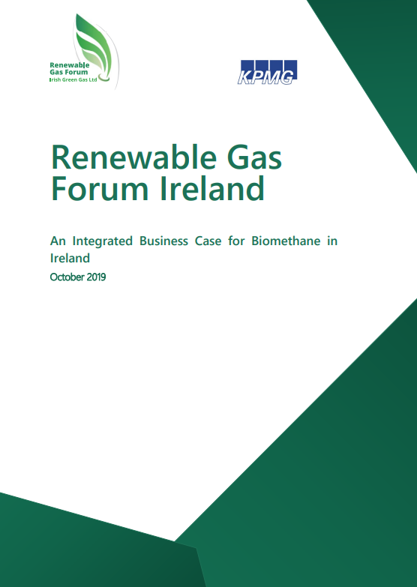
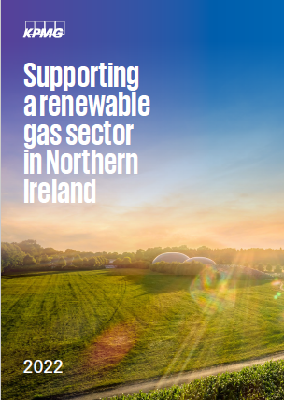
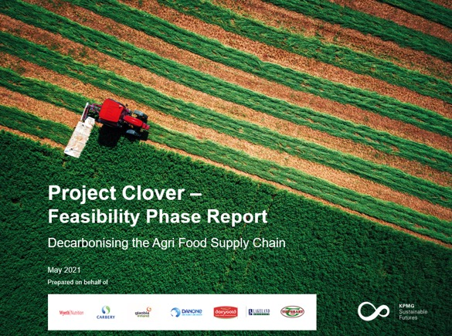
Making the case for biomethane in Ireland

Slide 3
Rapid growth is needed to achieve Ireland’s biomethane ambition
125 x 20 GWh Plants (2.5 TWh)
Source: Project Clover

Slide 4
Why the time is right for biomethane in Ireland
Historic Challenge | What’s Changed?
Economics - focus has historically prioritised the decarbonisation of electricity due to lower abatement cost, decarbonising heat received less attention and support | The need to reduce emissions from all sectors - biomethane is the lowest cost option to decarbonise many high temperature heat applications
Historically advocacy primarily from AD technology sector or developers – not a compelling option to Government | Industry is now demanding a supply of biomethane fuel in order to achieve their decarbonisation targets
Limited regulatory pressure / Government appetite | EU has set aggressive targets for both decarbonisation of heat and the production of biomethane Security of supply concerns has increased interest
Cautious government approach due to nervousness of impacting agri-sector dynamics | Studies have shown that Ireland has additional, untapped feedstock capacity which can assist farm-level decarbonisation and also reduce nitrogen based fertiliser usage
Government unwilling to lock into long-term subsidies to incentivise investments | The proposed Renewable Heat Obligation (RHO) scheme will provide long term support while placing no burden on Government funding
Developing an new energy sector, with the risk of unintended, negative consequences | There are now over 10,000 AD plants operating across Europe, with 80 operating in NI alone. Can work if done right
A challenging sector to secure funding | Significant increase in capital chasing this sector – AD now considered a mainstream technology

Slide 5
Biomethane is an expensive option for renewable electricity

Slide 6
Biomethane can be the cheapest option to decarbonise heat
Source: KPMG Analysis, 2020 costs in Ireland

Slide 7
Recently biomethane has become cheaper than fossil gas
NBP € c/kWh
Biomethane price range
Source: Intercontinental Exchange, KPMG Analysis

Slide 8
Why the time is right for Biomethane in Ireland
Historic Challenge | What’s Changed?
Economics - focus has historically prioritised the decarbonisation of electricity due to lower abatement cost, decarbonising heat received less attention and support | The need to reduce emissions from all sectors - biomethane is the lowest cost option to decarbonise many high temperature heat applications
Historically advocacy primarily from AD technology sector or developers – not a compelling option to Government | Industry is now demanding a supply of biomethane fuel in order to achieve their decarbonisation targets
Limited regulatory pressure / Government appetite | EU has set aggressive targets for both decarbonisation of heat and the production of biomethane Security of supply concerns has increased interest
Cautious government approach due to nervousness of impacting agri-sector dynamics | Studies have shown that Ireland has additional, untapped feedstock capacity which can assist farm-level decarbonisation and also reduce nitrogen based fertiliser usage
Government unwilling to lock into long-term subsidies to incentivise investments | The proposed Renewable Heat Obligation (RHO) scheme will provide long term support while placing no burden on Government funding
Developing an new energy sector, with the risk of unintended, negative consequences | There are now over 10,000 AD plants operating across Europe, with 80 operating in NI alone. Can work if done right
A challenging sector to secure funding | Significant increase in capital chasing this sector – AD now considered a mainstream technology

Slide 9
Industrial Demand for Biomethane
Dairy
Beverages
Nutrition
Agriculture
Others
Notes:
Recent news: 8 TWh of appetite for biomethane in 2030 (Interest in biomethane development exceeds production target (agriland.ie))
Others:
UnitedDrug – pharma company
BuJo – first restaurant chain to start cooking with biomethane (BuJo =burger joint)
Interested in biomethane:
From project clover: (Renewable Gas Forum Ireland | Project Clover calls for early implementation of RHO)
- Tipperary (https://cleanenergyministerial.org/sites/default/files/2020-06/CEM_EM_CASESTUDY_TIPPERARY_IRELAND)
Lakeland
DairyGold
Wyeth
Glanbia
Carbery
- Irish Distillers, led by Jameson (Irish Distillers announces plans for Midleton Distillery to become carbon neutral by 2026, using break-through emissions reducing technology | Irish Distillers)
Danone (Macroom | Danone)
Flynn’s Irish Tomatoes, switched to biomethane (https://www.gasnetworks.ie/corporate/news/active-news-articles/flynns-tomatoes/)
BuJo Burgers (BuJo burger outlets flip to biomethane - Business Plus)
Diageo and Tesco Ireland (https://www.bioenergy-news.com/news/naturgy-ireland-injects-biomethane-into-gas-grid/)
Aurivo (Biomass plant opens at Irish dairy site | Bioenergy Insight Magazine (bioenergy-news.com))
UnitedDrug (https://www.united-drug.com/blogs/news/united-drug-make-the-switch-to-renewable-gas-to-power-a-more-sustainable-future)
Aramark

Slide 10
Why the time is right for Biomethane in Ireland
Historic Challenge | What’s Changed?
Economics - focus has historically prioritised the decarbonisation of electricity due to lower abatement cost, decarbonising heat received less attention and support | The need to reduce emissions from all sectors - biomethane is the lowest cost option to decarbonise many high temperature heat applications
Historically advocacy primarily from AD technology sector or developers – not a compelling option to Government | Industry is now demanding a supply of biomethane fuel in order to achieve their decarbonisation targets
Limited regulatory pressure / Government appetite | EU has set aggressive targets for both decarbonisation of heat and the production of biomethane Security of supply concerns has increased interest
Cautious government approach due to nervousness of impacting agri-sector dynamics | Studies have shown that Ireland has additional, untapped feedstock capacity which can assist farm-level decarbonisation and also reduce nitrogen based fertiliser usage
Government unwilling to lock into long-term subsidies to incentivise investments | The proposed Renewable Heat Obligation (RHO) scheme will provide long term support while placing no burden on Government funding
Developing an new energy sector, with the risk of unintended, negative consequences | There are now over 10,000 AD plants operating across Europe, with 80 operating in NI alone. Can work if done right
A challenging sector to secure funding | Significant increase in capital chasing this sector – AD now considered a mainstream technology

Slide 11
Biomethane production has been growing steadily in Europe
GB produced
7 TWh in 2020
Source: European Biogas Association

Slide 12
RePowerEU set ambitious targets for biomethane production
Source: RePowerEU

Slide 13
Why the time is right for Biomethane in Ireland
Historic Challenge | What’s Changed?
Economics - focus has historically prioritised the decarbonisation of electricity due to lower abatement cost, decarbonising heat received less attention and support | The need to reduce emissions from all sectors - biomethane is the lowest cost option to decarbonise many high temperature heat applications
Historically advocacy primarily from AD technology sector or developers – not a compelling option to Government | Industry is now demanding a supply of biomethane fuel in order to achieve their decarbonisation targets
Limited regulatory pressure / Government appetite | EU has set aggressive targets for both decarbonisation of heat and the production of biomethane Security of supply concerns has increased interest
Cautious government approach due to nervousness of impacting agri-sector dynamics | Studies have shown that Ireland has additional, untapped feedstock capacity which can assist farm-level decarbonisation and also reduce nitrogen based fertiliser usage
Government unwilling to lock into long-term subsidies to incentivise investments | The proposed Renewable Heat Obligation (RHO) scheme will provide long term support while placing no burden on Government funding
Developing an new energy sector, with the risk of unintended, negative consequences | There are now over 10,000 AD plants operating across Europe, with 80 operating in NI alone. Can work if done right
A challenging sector to secure funding | Significant increase in capital chasing this sector – AD now considered a mainstream technology

Slide 14
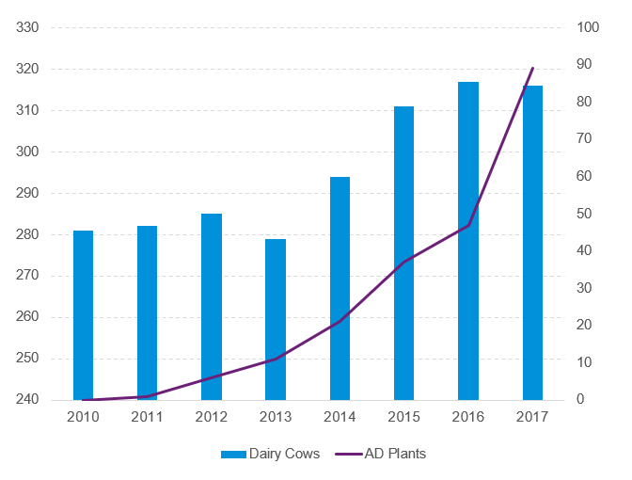
Experience from Northern Ireland’s agri-sector
Development of the NI AD sector
RoI Grassland Potential
 |  | Total
Total grassland | Mha | 4.5
Available grassland | Mha | 1.1
Suitable land | Kha | 768
Realisable production | Mt DM | 3.1
Realisable production | TWh | 9.5
Dowth Research Farm / KPMG Report
NI Grassland Potential
 |  | Total
Realisable production | TWh | 6.8
Queens / CASE Report

Slide 15
Why the time is right for Biomethane in Ireland
Historic Challenge | What’s Changed?
Economics - focus has historically prioritised the decarbonisation of electricity due to lower abatement cost, decarbonising heat received less attention and support | The need to reduce emissions from all sectors - biomethane is the lowest cost option to decarbonise many high temperature heat applications
Historically advocacy primarily from AD technology sector or developers – not a compelling option to Government | Industry is now demanding a supply of biomethane fuel in order to achieve their decarbonisation targets
Limited regulatory pressure / Government appetite | EU has set aggressive targets for both decarbonisation of heat and the production of biomethane Security of supply concerns has increased interest
Cautious government approach due to nervousness of impacting agri-sector dynamics | Studies have shown that Ireland has additional, untapped feedstock capacity which can assist farm-level decarbonisation and also reduce nitrogen based fertiliser usage
Government unwilling to lock into long-term subsidies to incentivise investments | The proposed Renewable Heat Obligation (RHO) scheme will provide long term support while placing no burden on Government funding
Developing an new energy sector, with the risk of unintended, negative consequences | There are now over 10,000 AD plants operating across Europe, with 80 operating in NI alone. Can work if done right
A challenging sector to secure funding | Significant increase in capital chasing this sector – AD now considered a mainstream technology

Slide 16
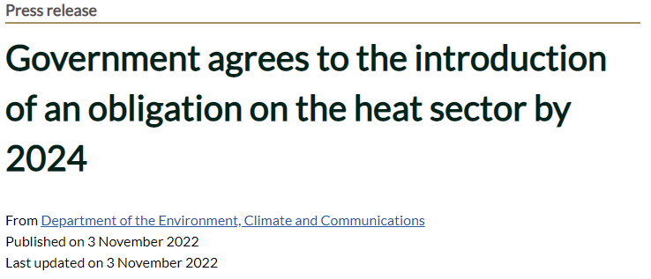
Renewable Heat Obligation (RHO) to be introduced by 2024
Source: DECC
Notes:
Ireland has one of the lowest share of renewable heat in the EU and want to have a sharp increase in this number through the RHO

Slide 17
Why the time is right for Biomethane in Ireland
Historic Challenge | What’s Changed?
Economics - focus has historically prioritised the decarbonisation of electricity due to lower abatement cost, decarbonising heat received less attention and support | The need to reduce emissions from all sectors - biomethane is the lowest cost option to decarbonise many high temperature heat applications
Historically advocacy primarily from AD technology sector or developers – not a compelling option to Government | Industry is now demanding a supply of biomethane fuel in order to achieve their decarbonisation targets
Limited regulatory pressure / Government appetite | EU has set aggressive targets for both decarbonisation of heat and the production of biomethane Security of supply concerns has increased interest
Cautious government approach due to nervousness of impacting agri-sector dynamics | Studies have shown that Ireland has additional, untapped feedstock capacity which can assist farm-level decarbonisation and also reduce nitrogen based fertiliser usage
Government unwilling to lock into long-term subsidies to incentivise investments | The proposed Renewable Heat Obligation (RHO) scheme will provide long term support while placing no burden on Government funding
Developing an new energy sector, with the risk of unintended, negative consequences | There are now over 10,000 AD plants operating across Europe, with 80 operating in NI alone. Can work if done right
A challenging sector to secure funding | Significant increase in capital chasing this sector – AD now considered a mainstream technology

Slide 18
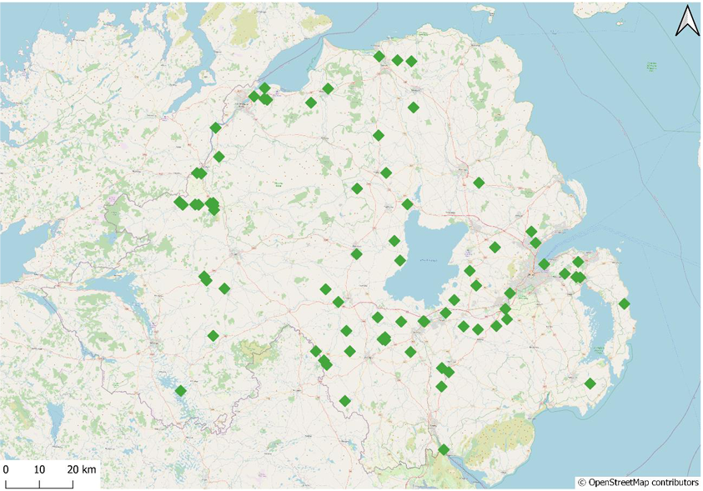
80 Operational AD Plants in NI
Source: Anaerobic Digestion in Northern Ireland Briefing Paper

Slide 19
Increasing Grass Production without Increasing Emissions
32 hectare farm with c.30 beef cattle
Farm with Cattle
For the whole farm | Baseline year | Year 1 | Year 2 | Year 3 | Year 4 | Year 5
Total Grass DM utilised | 194 | 312 | 349 | 351 | 355 | 360
Carbon footprint tnsCO₂e | 122 | 98 | 112 | 100 | 111 | 111
Farm with no Cattle
For the whole farm | Baseline year | Year 1 | Year 2 | Year 3 | Year 4 | Year 5
Total Grass DM utilised | 194 | 337 | 340 | 343 | 343 | 346
Carbon footprint tnsCO₂e | 51 | 17 | 8 | 18 | 9 | 12
Source: KPMG / Devenish Report 2022

Slide 20
Why the time is right for Biomethane in Ireland
Historic Challenge | What’s Changed?
Economics - focus has historically prioritised the decarbonisation of electricity due to lower abatement cost, decarbonising heat received less attention and support | The need to reduce emissions from all sectors - biomethane is the lowest cost option to decarbonise many high temperature heat applications
Historically advocacy primarily from AD technology sector or developers – not a compelling option to Government | Industry is now demanding a supply of biomethane fuel in order to achieve their decarbonisation targets
Limited regulatory pressure / Government appetite | EU has set aggressive targets for both decarbonisation of heat and the production of biomethane Security of supply concerns has increased interest
Cautious government approach due to nervousness of impacting agri-sector dynamics | Studies have shown that Ireland has additional, untapped feedstock capacity which can assist farm-level decarbonisation and also reduce nitrogen based fertiliser usage
Government unwilling to lock into long-term subsidies to incentivise investments | The proposed Renewable Heat Obligation (RHO) scheme will provide long term support while placing no burden on Government funding
Developing an new energy sector, with the risk of unintended, negative consequences | There are now over 10,000 AD plants operating across Europe, with 80 operating in NI alone. Can work if done right
A challenging sector to secure funding | Significant increase in capital chasing this sector – AD now considered a mainstream technology

Slide 21
Biomethane Funding

Slide 22
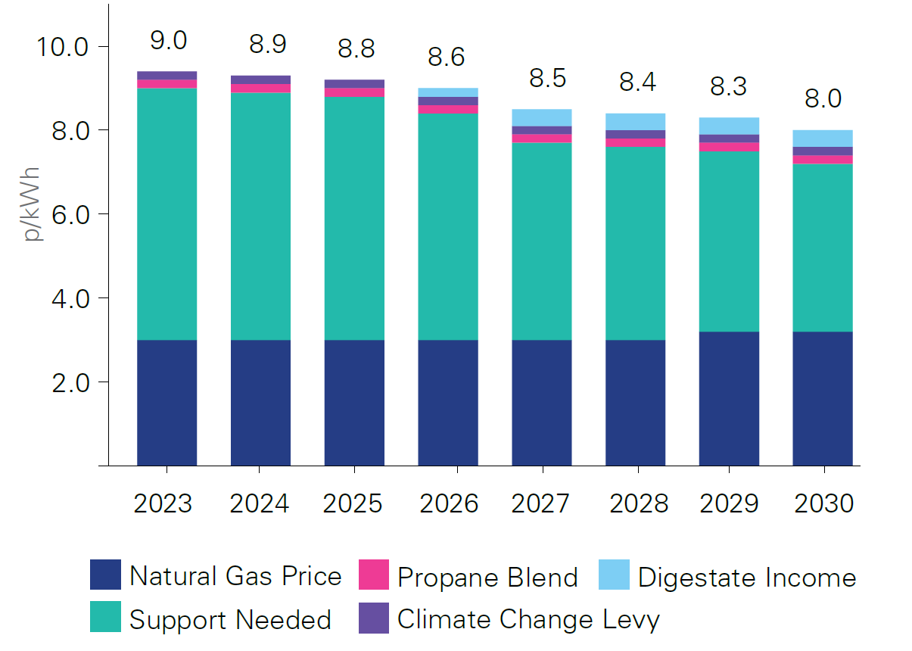
Biomethane plant economics & funding
Scale: 20 GWh+ Plant
Capex: €6m - €8m
Investment Return: 8%+
Biomethane Support: € 9c/kWh+
€ c/kWh

Slide 23
Green Finance is in Vogue
Total Global Sustainable Assets
Source: Global Sustainable Investment Alliance. Studies include 2012-2020. 2025 Forecast from joint research of GSAI and Bloomberg.

Slide 24
Global investment in low carbon tech/renewables is growing
Source: IEA World Energy Investment 2022

Slide 25
With vast flows of Private Equity capital…
Infra / Private Equity Funds & Asset Managers
Globally, VC and growth PE funding into the Low-Carbon sector exceeded $35 billion in 2021, making it the best year ever for Low-Carbon investments
Global Low-Carbon Investments by VC / PE Firms¹
$ in billions
PE giants globally have mobilized trillions of dollars to fight climate change and make Low-Carbon investments
Sources: 1) Pitchbook (PE funding includes only growth and expansion funding); 2) Climate Bonds Initiative.

Slide 26
Corporates are providing funding to support their supply chains…
Energy
Transportation and Supply Chain
Energy
Transportation and Supply Chain
To increase investment in Low-Carbon energy from $500M per year to $5B
Expects to invest >$10B between 2021 to 2028 in Low-Carbon intensity projects
Invests up to $10M in energy technology companies through its venture arm
Launched a $150M initial fund in 2015 to invest in mobility technologies
Combined capital of $900M in two funds to invest in sustainable transportation technologies
Venture arm of JetBlue, investing in early-stage startups catering to sustainable transportation
Eni invests in decarbonization projects and startups through its corporate venture arm
Launched a $1.4B fund in Nov-21 to fund energy transition start-ups and scale-ups
Launched a dedicated $400M energy transition fund in Oct-19 to invest in Low-Carbon technologies
Maersk Growth is the VC arm of A. P. Moller – Maersk with the mission to decarbonize supply chains
Launched Alliance Ventures in 2018 to invest up to $1B in five years in EV and sustainable mobility
Launched a $350M fund to invest in decarbonization projects and start-ups
Agriculture and Industrial
Consumer and Technology
Agriculture and Industrial
Consumer and Technology
Has invested $300M already in agritech-related technologies; plans to invest $250M more in the next decade
Venture arm of BHP, investing in decarbonization and sustainable resource extraction strategies
Venture arm of Caterpillar, investing in energy solutions, digital products, robotics, and advanced materials
Launched the $200M Restore Fund in Apr-21 to fund carbon removal technologies
Launched The Climate Pledge Fund to invest an initial $2B in Low-Carbon solutions providers
Plans to spend €1B on climate programs over the next five years to reduce greenhouse gas emissions
To invest $60M annually under its Future in Action program designed to reduce its carbon footprint
Venture arm of Sumitomo – has invested >$200M in technologies disrupting the green industrial sector
ArcelorMittal venture arm launched in Mar-21 to invest $100M in net zero carbon steelmaking
Invests in climate innovation solutions through its $1B Climate Innovation Fund
In 2021, announced $300M in grants to technologies involved in reforestation
Launched a €1B Climate & Nature Fund to invest in landscape restoration, reforestation, and carbon sequestration

Slide 27
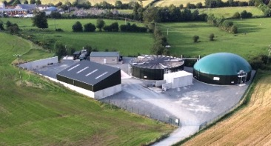
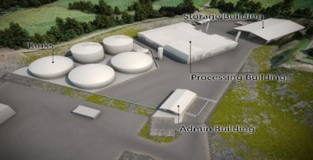
Biomethane Funding Options
Farm-Scale Plants
Industrial-Scale Plants
500kW on-farm AD plant
c.£3m development cost
Funded by various UK infrastructure funds
World’s first 100% poultry litter AD plant
c.£20m development cost
Funded by infrastructure fund, alongside InvestNI
NI 0.5MW AD Plant
NI 3.0 MW AD Plant
Debt
Equity
Grant
Energy Route-To-Market

Slide 28
Conclusions
Biomethane is an essential component of RoI’s decarbonisation pathway, with strong demand from industry;
Biomethane has the potential to decarbonise some of the hardest to abate carbon emitting processes at the lowest cost;
Policy, demand & environmental factors are now aligning – few structural barriers remain;
Using a grass-based agricultural system, Ireland has the potential to be a major player in biomethane production, using on-farm anaerobic digestion, alongside waste fed plants;
There is a wall of capital ready to fund the roll-out of the industry, however the sector will not develop without active policy support from the Government (incl. permitting processes) and a structured approach to asset development.

