Slide 1
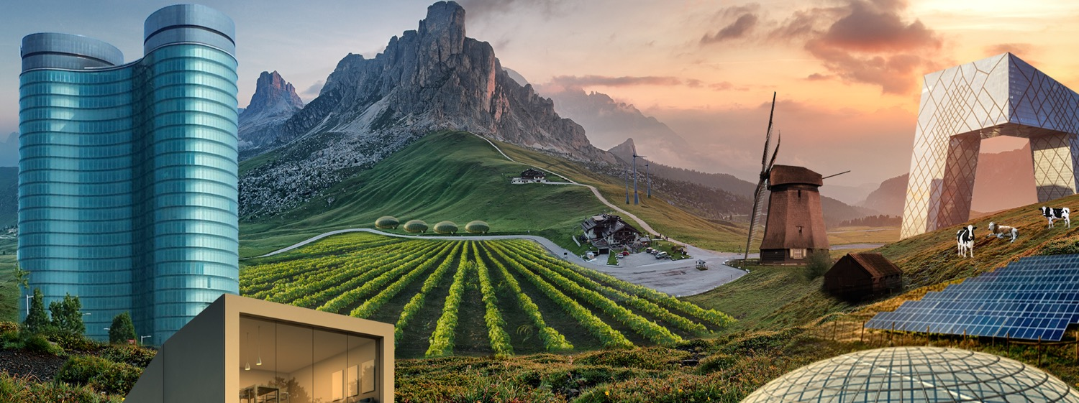
Lessons learned from 20 years + of financing Anaerobic Digestion
Markets and feedstock key drivers
Hans van den Boom
Investment Manager, Renewable Energy
Rabobank Project Finance

Slide 2
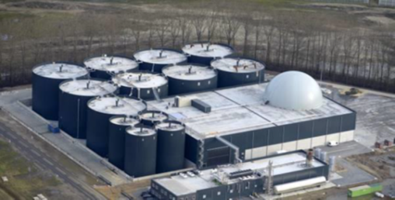
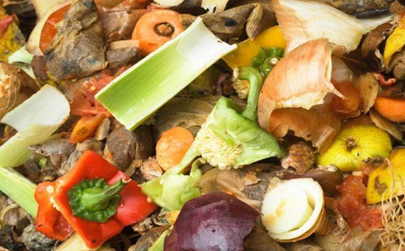
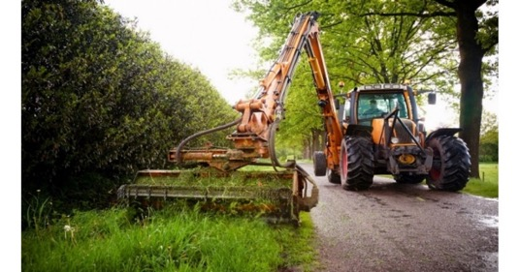
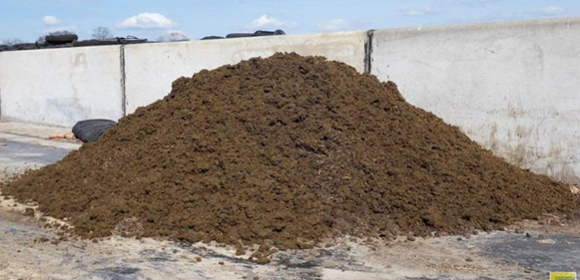
History and future (don’t generalize)
Subsidy-driven revenues mostly fixed for > 10 year
Germany: From energy crops based (Power by CHP) => transition into biomethane to the grid and or bio-LNG out of advanced feedstock (carbon intensity driven)
Belgium: (still only power, no gas to the grid) > 80% biogas out of F&A waste streams (partly energy crops)
Netherlands: mostly gas to the grid > 95% biogas out of F&A waste streams, no energy crops or rotation and catch crops
Denmark: Large scale projects mostly > 75% manure, declining % energy crops allowed, more depending on imported high yield F&A waste streams. Gas to the grid.
Ireland/Project Clover:
  Farm based, cattle slurry, excess grass silage, rotation and catch crops (meets RED II criteria now)
  Enables industry to decarbonise thermal energy requirements
What if!: Off takers requirements and/or legislation changes (RED III)?
Notes:
First warning: Local and national circumstances can differ enormously
Clover:
We saw in the past the high impact on changing legislation, adjustments of obligation.
For example in Denmark re decline of allowance for energy crops from 12 – 4% and in the end it must be 0%.
More and more market demands for low carbon intensity of the biomethane.
For example biomethane in Germany from only manure digesting gets the highest price for biomethane because of negative carbon footprint.

Slide 3
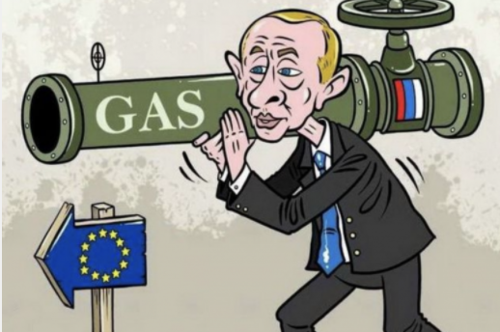
Geopolitical dependence
From subsidy-driven to market-driven
Notes:
More then any other European country, the Dutch economy and society depends on natural gas
Being (partially) dependant on other countries for energy in itself is not a problem. However, when the dependency is too big, you lose control over supply reliability and price
The oil crises of 1973 made other countries focus on energy saving and diversifying energy consumption (Denmark started investing in wind energy, France in nuclear energy). The Netherlands did not do this, because we were spoiled with natural gas

Slide 4

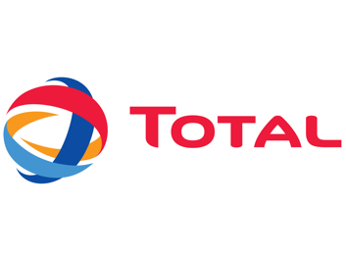

From subsidy-driven to market-driven
Lack of interest in biomethane from fossil oil/gas companies and traders until 3 years ago (production based on subsidy programs)
Now:
Under RED II growth path (transport sector) biofuels until 2030 must come from advanced feedstock; other industries also take action to achieve their sustainability goals
Fossil fuel energy companies want biogas:
If nececessary, they become a shareholder or financier and offer long term off-take contracts up to 15 years
Acquisition of biogas developers/operators
More demand than supply => high prices for GOOs
Notes:
In the oil business we don’t give long term contracts.
Then you won’t get Bio-LNG
Projects cannot take market risk!
I never had so many meetings with oil companies, local utility owners, oil and gas traders, traders in Certificates and so on. They all want the biogas!
So for the farmers here maybe you have gold in your hands ☺, but how do you get it in your pockets ☺

Slide 5
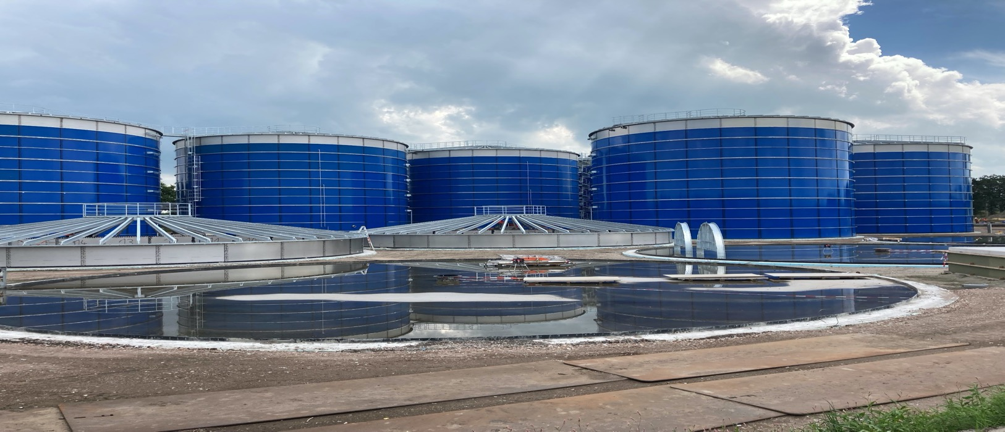
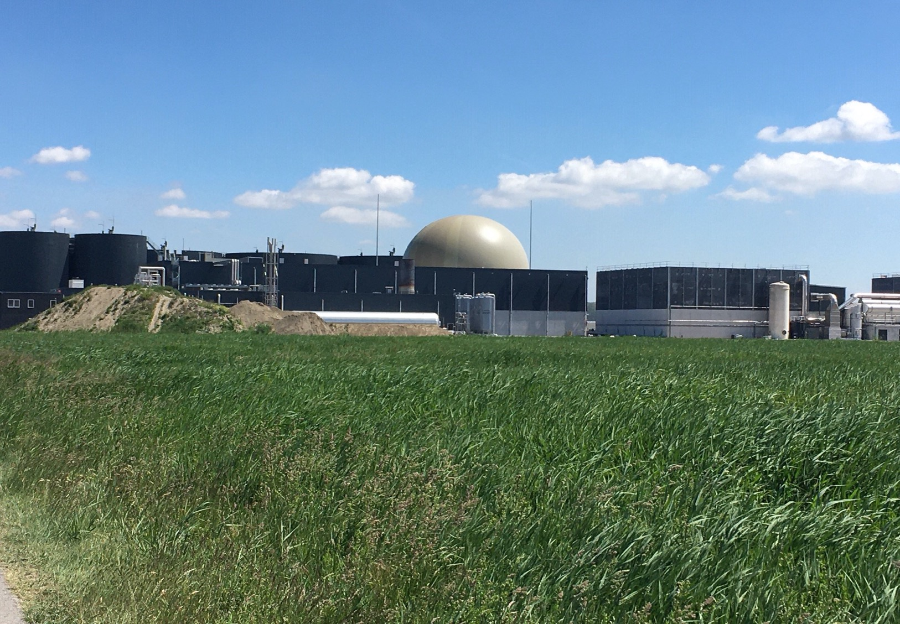
Renewable gasses: endless growth market
But how to build a robust & profitable project!
Strictly private and confidential
Notes:
A lot of processes are possible to electrify

Slide 6
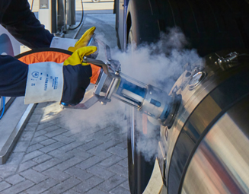
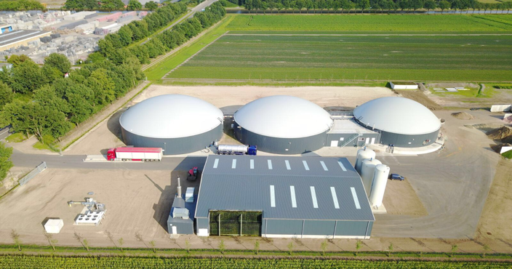
Most critical issues impacting on profitability
Good operational and financial management (24/7 process, changing markets)
Development of input-output costs (2022 in NL/Belgium/Denmark > +25%)
Power costs (around 1 kWh power for 1 m³ biomethane)
Flexibility to respond to new markets (type of certificates)
Notes:
Don’t under estimate managing a digester. Operational management makes the difference.
We have clients who produced for > 10 years under subsidy regime and are now producing unsubsidized for the transport sector.
When the Clover Project suffers from an increase in feedstock costs and power prices only higher revenues for biomethane can compensate that.
Actual high gas prices support recovery of profit for most biomethane to the grid projects.
For new projects or new contracts it is right now very difficult to predict which market to produce for.

Slide 7
Developing a profitable, sustainable and bankable project
Lessons learned & key drivers:
Flexibility:
    Permit (how many tons and which feedstocks are allowed?)
    Retention time (100 days?)
    Storage capacity
    …….
Proven technology from experienced constructors (with used feedstock)
Entrepeneur with operational and financial management skills (problem solving abilities)
Competitive cost price (benchmark assumptions)
“fixed” revenues > 10 year (and or feedstock cost related)
Risk bearing capital (30-50%)
DSCR > 1.6
Notes:
It isn’t easy when you feed a lot of excess grass sliage or rotation crops. (you need to shrink !)

Slide 8
Conclusions
Good projects are financeable (made-to-measure)
Dynamic sector with very good market perspectives
The challenge will be availability and price of sustainable feedstock in relation to revenues and changing markets

