Slide 1
Renewable Gas Certification
Milenko Matosic, 09.11.2022, Dublin

Slide 2
Topics
Dena Biogasregister
The REGATRACE Project
Renewable gas certification
Standardized GOs and cross-border trade
GOs and ETS

Slide 3
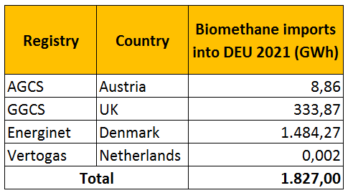
Dena biogasregister
Tracking system for the production & consumption of bio-CH4, H2 & synthetic methane
~ 200 biomethane plants and 3 PtG (H₂) plants
Participant of the ERGaR CoO Scheme for international transfers of biomethane certificates (book & claim).
Present transfers: DK, UK, NL→DE
Founded in 2010
Operated by the German Energy Agency (dena)
Documents evidence of the use of biogas for electricity (RE Act, EEG) and heat in buildings (Buildings Energy Act, GEG).

Slide 4
Started in June 2019 and will end on 16 November 2022→ Final conference
Funded by EU´s Horizon 2020 research and innovation program with €3,000,485.
Aim: create an efficient trade system based on issuing and transfer of biomethane/RG certificates (including GOs)
8 Target countries: BE, CZ, IE, IT, LT, PL, SK, ES
Favor the uptake of the European biomethane market.
Prevent double counting
8 Work Packages: dena led WP3 “Setup of national GO issuing bodies” (report available online) and led Deliverable 4.1 “Guidelines for the verification of cross-sectoral concepts” (report online)
Irish registry: operated by GNI since 1 October 2020 and first registry to become operational during REGATRACE.

Slide 5
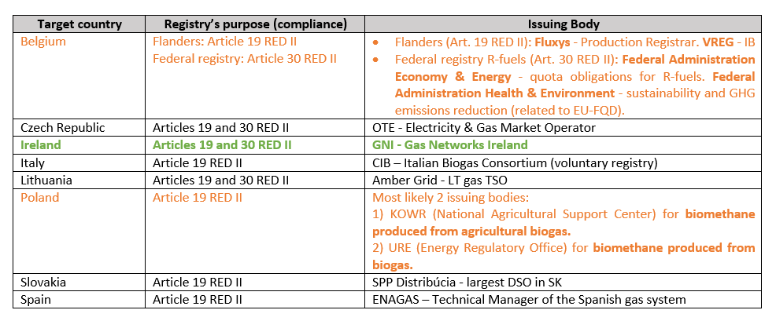

Slide 6
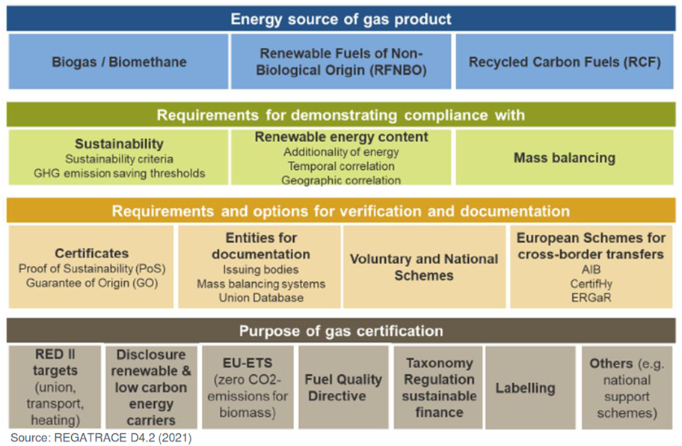
The European framework for renewable gas certification

Slide 7
Guarantees of origin (RED II)
Definition: an electronic document which has the sole function of providing proof to a final customer that a given share or quantity of energy was produced from renewable sources.
Purpose: consumer disclosure and issued by MS at the request of a producer of energy from RES. Standard value: 1 MWh
Worth noting:
GOs not eligible for accounting to national renewable energy targets
MS shall not recognise GOs issued by a third country except where the Union has concluded an agreement with it on mutual recognition of guarantees of origin and only where there is direct import or export of energy.

Slide 8
Standardized GOs and cross-border trade
Why do we need a harmonised GO system?
For the uptake of the biomethane/RG market and cross-border trade → confidence to gas producers and consumers
Avoiding double counting
What about energy policy and regulation?
Clear & ambitious targets for RG production & consumption → confidence for investors on both sides
First attempt: ERGaR CoO Scheme launched in July 2021 with dena (DE), GGCS (UK), Vertogas (NL). In the process of joining: Energinet (DK).
Article 19 (6) RED II: issuance, transfer and cancellation of GOs must comply with the CEN Standard EN16325.
CEN Standard EN16325: in revision since February 2020.
Include electricity, gas, H2, heating and cooling.
Harmonize the issuance, transfer and cancellation of GOs in Europe.

Slide 9
Standardized GOs: Benefits
Basis for a European market for biomethane and RGs
Level playing field for all stakeholders → fair competition
Stronger linkage between energy and industrial sectors → more synergies, new business models
For industry: lower environmental taxes, less EU- and national ETS compliance, etc.
For population: less environmental impact compared to fossil fuels.
Circular economy: creation of new supply chains, waste & residues revalorization, new jobs.
Facilitate sector coupling: bio-LNG & green H2 → transport & industry
Certificates from dena’s Biogasregister can be used for the EU- and national ETS

Slide 10
Biomethane & Eu targets 2030
Share of RES in final energy consumption: 32% (Article 3 RED II)
REPowerEU: 35 bcm of biomethane production per year
Heating & cooling: a RES share increase of 1,3% every year (Article 23 RED II)
Biomethane industrial partnership
Share of RES in transport sector: 14%, with a minimum share of 3,5% for advanced biofuels (Article 25 RED II)
Gathers policy makers, industry and other stakeholders for reaching the 35-bcm-biomethane target.
Reduction of primary energy consumption: 32,5%
Create preconditions necessary for a further ramp-up of its potential towards 2050.
GHG emissions reduction: at least 55%

Slide 11
Sustainability criteria and pos
GOS cannot be used for target accounting. What now?
Article 29 RED II: energy from biofuels, bioliquids and biomass fuels shall be considered for target accounting (Arts. 3(1) and 25 RED II)
Article 30 RED II: economic operators must comply with the sustainability and GHG emissions saving criteria from Art. 20 RED II.
Condition: fulfil the sustainability & GHG emissions saving criteria
They shall use a mass balance system for these purposes.
New concept: Proof of Sustainability (PoS)

Slide 12
Sustainability criteria and pos
Union Database
Registration of PoS for avoiding double counting
Connected to the MS databases
Planned start of operation: end of 2022
Question still remaining open: how (and if) GOs should be included in the UDB and linked to the respective PoS?

Slide 13
Biomethane Gos and Ets
EU Monitoring and Reporting Regulation (MRR)
Biomass definition: same as in RED II
Article 38: zero emission factor for biomass
Article 39 (3): allows usage of GOs of biomethane injected into the grid
Biomethane GOs are not recognized in all countries for ETS
Until today, only Germany allows foreign biomethane
GO and (from 2023 onwards) PoS necessary, mass balanced only

Slide 14
Thank you for your attention!
Milenko Matosic
milenko.matosic@dena.de
www.dena.de

