Slide 1
VISIONGREEN
CONSULTANCY
Biomethane to Support Decarbonising the Transport (HGV) Sector
Wednesday, 9th November, 2022
visiongreenconsultancy.ie

Slide 2
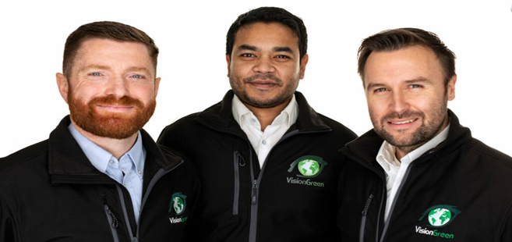
Who are we?
VisionGreen was set up in 2018
Purpose driven business based in Carlow and Dublin, Ireland
First biomethane fueled vehicles on road in Ireland
Have developed renewable gas solutions for retailers in the past
Working with DHLSCI for 2 years on sustainable strategy
Helping to source biomethane for DHL in Ireland and Europe

Slide 3
Our Products and Services
Sustainable Transport Solutions
Carbon Assessment
Green Services for SMEs including Grant Support
Renewable Energy

Slide 4
First Movers
In partnership with BWG Foods / Spar group and Green Generation Ltd, VisionGreen Logistics Solutions Ltd was the ﬁrst Logistics company in Ireland to make retail deliveries on gas powered vehicles fueled with Biomethane.
The Biomethane was generated from food waste from BWG Foods Distribution centre making it a circular economy solution for Ireland.
Concept initiative to demonstrate what can be done to reduce emissions in Transport in Ireland.

Slide 5
Heavy Duty Alternatives to Diesel - Gas Powered Vehicles
20% less emissions vs diesel with CNG
90% less emissions than diesel with Biomethane
Refueling infrastructure limited but developing
Similar range to diesel vehicles
With exception of current global issues cost per kilo vs diesel has been very competitive over last 5 years
Vehicle purchase grants available to support transition
Active solution on Irish roads as we speak

Slide 6
Our clients and partners

Slide 7
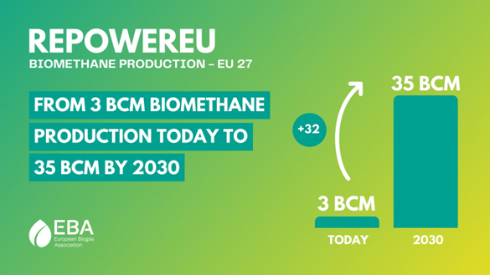
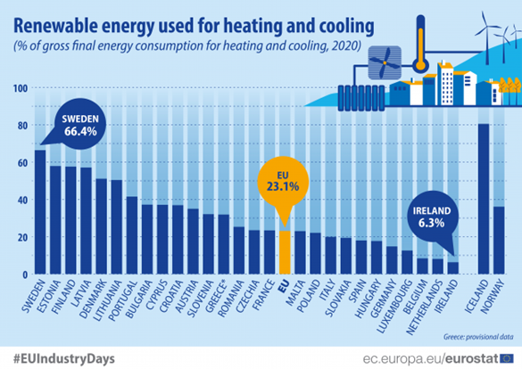
Biomethane Policy
EU Update
European Commission announced target for production of 35 billion cubic metres (bcm) of biomethane within the EU by 2030 as part of its REPowerEU Plan.
Currently producing 3 billion cubic metres.
€83 bn needed to build 4,000 medium-size plants and 1,000 large-scale plants.
Ireland
Ireland has set a target of 5.7 TWh of biomethane by 2030 (36 large scale plants).
Ireland’s heat has the lowest percentage of renewable energy (6%) of any European country.
Introducing a Renewable Heat Obligation which will require suppliers to provide a proportion of their fuels from renewable sources.
Already included in the Biofuels Obligation scheme and due to receive x 1.5 certs from 2023

Slide 8
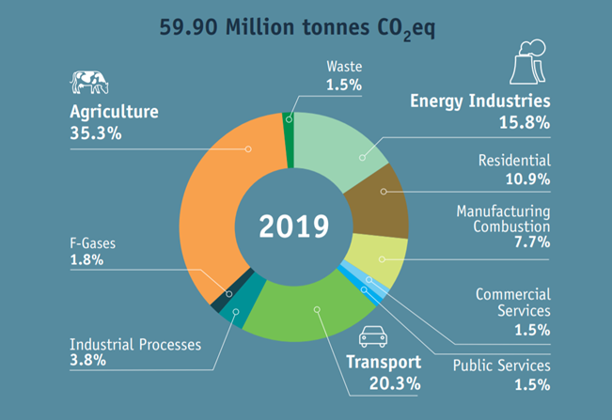
Transport Emissions
Transport is Irelands second largest at 20% - only 5% carbon reduction since 1990
HGV and marine sectors very difficult to decarbonise as electrification largely not possible
There were approximately 136,000 HGVs in Ireland in 2020 accounting for 15% of transport energy. The fleet relies solely on diesel. Just 57 trucks are powered by Compressed Natural Gas (CNG), the rest are diesels of various vintages.
Ireland has a relatively old fleet with approximately 55% of HGVs 6 years old or more meaning they do not meet the 2014 increased Euro VI emissions standards.
Barriers to investment in new technologies such as high competition, low margins and a high share of small businesses.
Lack of clear consensus internationally has also slowed progress with European countries often pursuing different measures.

Slide 9
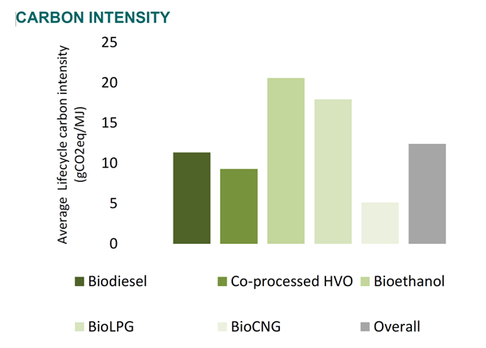
Why Biomethane
The need for further actions to reduce emissions in the transport sector must be addressed without delay.
Although green electricity for mobility is making strides, it cannot single-handedly meet the expected and much needed decarbonization deadlines in time.
Biomethane is readily available and allows for the fast decarbonization of all transport areas.
Grid Infrastructure is already in place.
It is a versatile sustainable fuel which can be compressed to Bio-CNG or liquefied to Bio-LNG
Lowest carbon intensity biofuel available (if used as Bio-CNG), depending on the feedstock used it can be carbon negative.
By comparison electricity is currently 82 gCO2/MJ in Ireland, has a target of 28 by 2030 and 0 by 2050.
Adds to energy security and can be financially decoupled from energy markets.

Slide 10
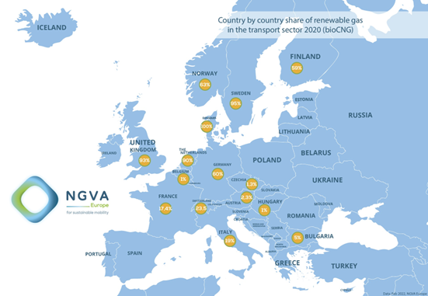
Biomethane in Transport Europe
4,110 CNG and 500 LNG stations
Over 10,000 CNG/LNG trucks registered in Europe in 2021 (up 41% from 2020).
Only a quarter of the gas used in road transport in Europe is renewable
Trading rules allow the sale renewable gas to the transport industry across Europe
Estimated that by 2030, over £1bn worth of biomethane will be sold annually to the UK HGV market alone
Major brands switching to Biomethane include John Lewis Partnership, Waitrose, Royal Mail, Warburtons, Farm Foods, Hermes, Ocado, Carrefour and Wessex Water

Slide 11
Challenges
Geopolitical issues (Ukraine & COVID) driving up cost of gas and causing increased vehicle delivery lead times for new units.
Roll out of public and private fueling infrastructure has been slow to date - Only four public CNG Fueling stations on the island.
Process of commissioning fueling infrastructure with regulator has led to delays on several sites.
Lack of public awareness of the beneﬁts of Biomethane production through Anaerobic Digestion in Ireland.
Lack of government support for Anaerobic Digestion industry in Ireland to date.
Currently only one plant in Ireland producing Biomethane for grid injection.

Slide 12
Opportunities
REPowerEU
EU Energy Platform - to enable voluntary common purchases of gas, LNG and hydrogen.
EU External Energy Strategy - to facilitate energy diversiﬁcation and building long-term partnerships with suppliers, including hydrogen or other green technologies.
Biomethane Action Plan - to set out tools including a new biomethane industrial partnership and ﬁnancial incentives to increase production to 35bcm by 2030, including through the Common Agricultural Policy.
(European Commission, 2022)

Slide 13
Wish List
Development of an indigienous AD Biomethane industry in Ireland to support reducing emissions and improve fuel security.
Extend the treatment of excise duty on gas (set to expire Dec 24).
Review potential to remove toll charges for gas powered vehicles.
Provide additional grant support and tax relief to stimulate purchase and uptake of gas powered HGV’S.
Streamlined planning and commissioning process with the regulator for CNG fueling infrastructure.
Capital support to accelerate roll out of fueling infrastructure in Ireland.
Education and awareness of the beneﬁts of AD Biomethane as a renewable fuel for Transport in Ireland.
Industry, sectoral & government collaboration to support driving forward the use of Biomethane for Transport in Ireland.
Conﬁdence in innovation & technology and our ability as a nation to meet this challenge.

Slide 14
T H A N K S F O R Y O U R T I M E
www.visiongreenconsultancy.ie

