Slide 1
Sustainable Aviation Fuel
RGFI
9th November 2022
Clontarf Castle, Dublin , Ireland.

Slide 2
Content
SFS Ireland & SkyNRG – Project Introduction
Future Fuels
What is SAF
Biogas as a Feedstock?
Opportunities for Ireland

Slide 3
SFS Ireland
Team formed in 2020 – Team is growing: LTD Company Est 2021
Mission statement: Aviation Industry Decarbonisation
Development of Sustainable Aviation Fuel Projects & Markets.
Partnered with SkyNRG to lead an Irish project supported by 3 leading companies from the Aviation industry.

Slide 4
Irish SAF Feasibility Study Progress…
Well-defined boundary conditions for the SAF facility.
Desk research and stakeholder engagement.
1 or 2 pathways (feedstock & technology combination)
SAF workshops: Shortlisting based on consensus with all project partners.
Techno-economics
Site selection
Sustainability assessment
Test the viability of a local business case.
Feedstock assessment
Shortlisting
Feasibility study
Phase 1a
July – September
Phase 1b
October - December
Phase 2
2023
4

Slide 5
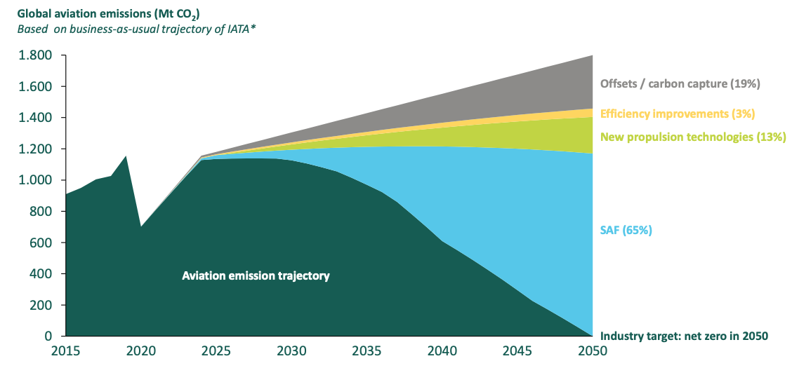
Future Fuels...
Notes:
However, as things stand, there is no SAF industry in Ireland. Nor is there a roadmap to start one. The commercial and economic threat of doing nothing is real. Meaningful action and stakeholder engagement are necessary to ensure aviation recovers towards a new, sustainable future.
Source: HSBC report, with data taken from ATAG’s “Waypoint 2050” report

Slide 6
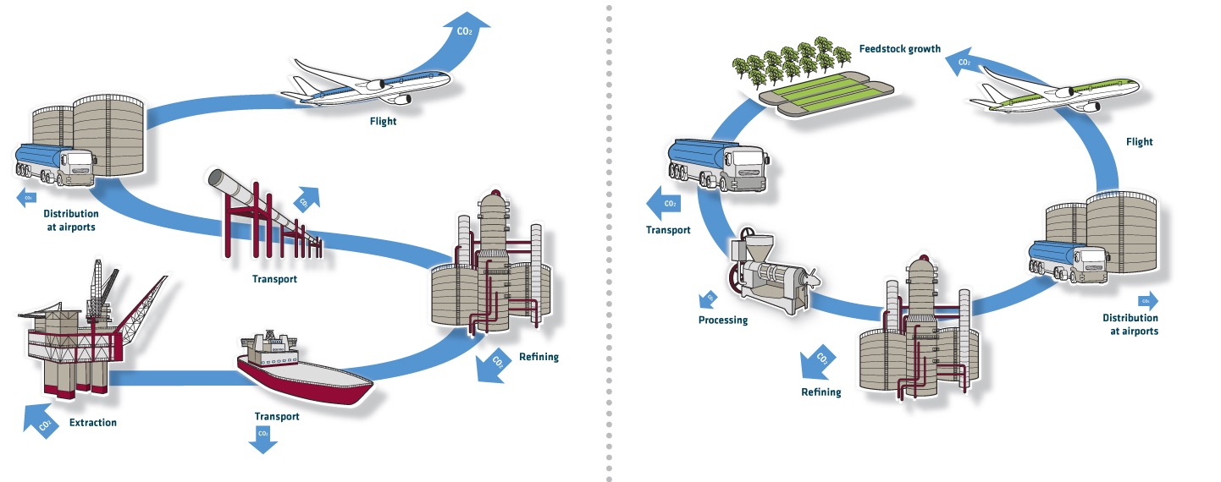
What is Sustainable Aviation Fuel?
Fossil Fuel Carbon Life Cycle
SAF Carbon
Life Cycle

Slide 7
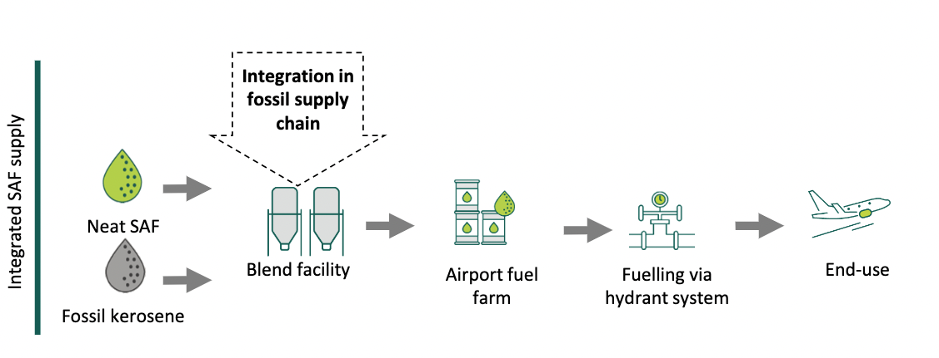
What is Sustainable Aviation Fuel?
Source:

Slide 8
What is Sustainable Aviation Fuel?
ReFuel EU: Proposed EU SAF Blending Mandate
Penalties apply to Fuel suppliers & Airlines!

Slide 9
Biogas as a Feedstock?
Chosen Pathway depends on many variables…
Feedstock:
Biogas
Fischer-Tropsch (FT)
Neat SAF
Alcohol to Jet (ATJ)
Neat SAF
Biogenic CO₂
Power to Liquid H₂
Neat SAF

Slide 10
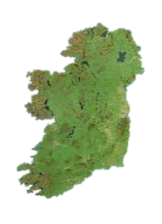
Opportunities for Ireland
Opportunities for the Biogas Industry:
Demand security: Longer Biogas Off-take contracts
Long-term demand security through EU mandates for SAF
Biogas Demand for a 100kt SAF Plant is significant: 200 Million M³
2. Regional Employment
A new domestic industry with huge growth potential will offer significant economic opportunities for rural communities
Opportunities for Ireland:
A SAF Manufacturing Industry must deliver
Sustainable economic growth
Circular Bio-Economy player
No Displacement effects
Regional Development
Secure Affordable
Low Carbon

Slide 11
THANK YOU
Contact us anytime at
info@sustainableflightsolutions.com

